Slide 1
A Proposed Framework for ISAOs Responding to Misinformation Campaigns
PABLO BREUER and SARA “SJ” TERP
IISC, San Antonio, 2019
Notes:
Hello. Today we’re going to be talking about mapping misinformation attack and defense into existing infosec frameworks, and how that mapping allows us to plan misinformation defenses and counters, assess tools and mechanisms, and handle the types of large-scale adaptive threats that mlsec makes possible. This should help misinformation response move past the intelligence and passive defense stages of the SANS sliding scale.

Slide 2
Agenda
Introduction
Information warfare and nation-states
Mechanisms of influence
Mitigations and challenges
Designing shared responses
Misinformation framework standards
Populating misinformation frameworks
The way ahead

Slide 3
INFORMATION WARFARE AND NATION-STATES
War is an act of force to compel the enemy to do our will
Clausewitz
Notes:
As with many technologies, long before crossing over into the private sector, large-scale influence was primarily used by nation-states for military and political purposes, so we will take a look at these roots and how they translate into a business context. The central importance of psychology and social manipulation in warfare was recognized by Clausewitz, Sun Tzu, and Machiavelli. Clausewitz’s observation is particularly relevant: War is not about breaking things and hurting people; winning a war is about affecting your opponent’s will. It’s about changing their minds.

Slide 4
WHERE’S THE CYBER?
PSYOPS
Operation Security
Computer Network Operations
Information Warfare
Electronic Warfare
Military Deception
Notes:
Many of you may wonder why this is getting talked about at a cyber conference. The problem is that cyber is not a noun, it’s an adjective. Historically, the US Department of Defense would talk about Information Operations having five pillars: PYSOPS, Computer Network Operations Electronic Warfare, Military Deception, and Operational Security. When most people say “cyber” they usually mean a combination of two or more of these pillars. These days, most information warfare - or influence operations - are enabled by computer network operations or operational security.

Slide 5
MOST CYBERSPACE OPERATIONS ARE BASED ON INFLUENCE
Force and adversary to make a decision or take an action based on:
Information I hide
Information I give
Information I change
Information I deny/degrade
Information I destroy
Enable my decisions based upon knowing yours
“Operations to convey selected information and indicators to audiences to influence their emotions, motives, and objectives reasoning, and ultimately the behavior of governments, organizations, groups, and individuals”
Notes:
“Psyops is what it’s called when the government does it - misinformation is the nicer, more genteel term for this” In most cases, the desired effect of cyberspace operations isn’t on a computer - it’s on the person at the other end of the computer. These operations serve to have the target person make a decision based advantageous to us based on information that we present to them through their computers and networks.

Slide 6
WESTPHALIAN SOVEREIGNTY
Each nation has sovereignty over its own territory and domestic affairs
Principal of non-interference in another country’s domestic affairs
Each state is equal under international law
Notes:
Westphalian definition of a nation state is based on sovereignty
Come into existence at end of 30 years war where over 8 million died
Is the basis for modern international discourse

Slide 7
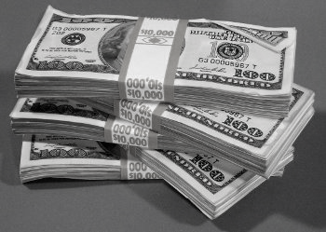
NATIONAL INSTRUMENTS OF INFLUENCE
Resources available in pursuit of national objectives…
Diplomatic
Informational
Military
Economic
…and how to influence other nation-states.
Notes:
In military and political theory, nations have these “levers” they can pull on to influence other nations. These levers are collectively referred to as DIME: Diplomatic, Informational, Military, and Economic.
Usually referred to as the DIME model

Slide 8
BUSINESS INSTRUMENTS OF INFLUENCE
Resources available in pursuit of corporate objectives…
Business Deals & Strategic Partnerships
PR and Advertising
Mergers and Acquisitions
R&D and Capital Investments
Notes:
In the business world, “Diplomatic” translates to your business deals and strategic partnerships. “Informational” translates to PR & advertising. “Military” doesn’t completely translate, at least not yet, but it does have an analogue in aggressive activities such as hostile takeovers, industrial espionage and strategic acquisition and enforcement of intellectual property. “Economic influence” translates to capital investments, research and development, and investments. Apple's infringement lawsuit of Samsung is an example of the former and their strategic purchase of Intel’s 5G modem business of the latter; among other reasons, they probably want to retain their ability to compete with Huawei.
So the instruments of influence are relevant and available to business. They’re available to prop up your own business and to attack your competitors.

Slide 9
INFORMATION THREATS
Democracy
Require common political knowledge
Who the rulers are
Legitimacy of the rulers
How government works
Draw on contested political knowledge to solve problems
Vulnerable to attacks on common political knowledge
Autocracy
Actively suppress common political knowledge
Benefit from contested political knowledge
Vulnerable to attacks on the monopoly of common political knowledge
Notes:
https://www.schneier.com/blog/archives/2018/11/information_att.html?fbclid=IwAR3l6zYAWUmzdkPwWbX6Kl-mbKPRG2gS25E5sSch_5celRUHfEaNTGerIRU

Slide 10
EVOLUTION OF INFORMATION
Notes:
Until around 1440 CE, if you wanted to transmit a message, the only way to do it was to write it out and carry it. The states and the church would employ monks to hand-copy messages and books and they’d be hand-carried to their destination. Literacy was not common and parchment and ink were expensive. So the creation, transmission, and reception of messages could only be carried out by a select few. Sure, once a message arrived at its destination, a town crier or religious figure could “transmit” the message to anyone within earshot, but addressing a mass audience was difficult, slow, and required significant resources and required specialized knowledge.
In 1455 came the invention of the Gutenberg press and movable type. This was the very first step in the revolution of communication being not only facilitated, but amplified by technology: for the first time, a message could be multiplied and broadcast to a mass audience. The equipment and initial setup was expensive and arduous, but once the press was set, reproduction in large numbers was easy. Transmission still required physical transportation, but more copies transmitted meant more people received the message first-hand.
This was also the first invention where we clearly saw unanticipated, disruptive consequences. The church was a big proponent of the Gutenberg press for printing Bibles. I guess they never thought that Martin Luther would use the same technology to put out “fake news” in the form of his 95 theses and post it all over town.
In the 1830s came the invention of the telegraph. The power of the first electrical telecommunications system was clear and the infrastructure was rapidly deployed, with the US and Europe mostly covered within 20 years and connected by transatlantic cables soon after. Transmission was only station-to-station and limited to those with specialized knowledge of Morse Code, but once again the new technology had a profound effect on society. Effective use of the telegraph helped the United States defeat the Confederacy in the Civil War. And in the Crimean war, although the Allies defeated Russia, the day-by-day reporting on the horrors of war led to violent anti-war protests in London and the resignation of the Prime Minister. Crimea was actually the first conflict to be extensively influenced by the telegraph, and fortunately, it was also the last time the Crimean Peninsula was ever involved in a controversial conflict involving Russia and public sentiment in the West being swayed by mass communication. (Just kidding.)
In 1895 Marconi’s radio became the real game-changer in telecommunication. Now a single source could broadcast a simple, unmistakable human voice directly into millions of homes all at once. Recognizing the power of this new medium, governments enacted strict new regulations, but radio rapidly became the universal medium for news and entertainment. And we see something that seems to become a pattern in subsequent developments in communication technology: a honeymoon period, where people seem to take everything at face value, followed later by the development of skepticism and even mistrust. In 1938, the broadcast of “War of the Worlds” sounded similar enough to a real news broadcast that it led some people to panic, was followed by widespread complaints—particularly in the newspapers—that radio was deceptive and unreliable, and needed to be regulated for factual quality. And then they solved the problem of fake news. (Just kidding.)
----------------------------------
While there is some amount of knowledge required to tune a radio, once tuned, anyone can transmit a message with the spoken word. Instant communication of information over a relatively wide geographic distance is now possible. Even more important is that anyone within transmission range with a radio is capable of receiving the transmitted information without the need for specialized knowledge. Radios are still relatively expensive, but the price drops drastically.
As the price drops and more have access to the ability to transmit, government realize that this medium must be regulated. In 1910 the US Congress passed the first regulation of radio to restrict the number of stations and physical limitations of those stations. In 1927 further regulation is passed that severely restricts public and private transmission. In 1934 the US starts the Federal Radio Commission and regulation increases. The results of progressive regulation is that the number of people that can transmit is limited as is the range at which they can transmit. This eventually leads to the FCC and parsing of frequencies for various purposes that must be licensed and is therefore back in the control of nation-states.
So the radio enables a much larger audience to be reached almost instantly without the need for specialized knowledge. The audience merely needs to own a simple and relatively inexpensive device and tune in to hear the message. Who can transmit to wide audiences, however, is limited to those that can not only afford a license, but convince the government to afford them a license.
The radio becomes the defacto standard of truth and news. Families gather around the radio for news and entertainment. What could possibly go wrong? In 1938 we find out when “War of the Worlds” is transmitted for entertainment and leads to panic when many of the audience believe they’re listening to news coverage. There’s widespread outrage by the press claiming that the broadcast is deceptive and calling for regulation. I’m really glad we have that solved.
In the 1920s and 30s television became another game-changer. For the first time we could transmit not just words, but moving pictures. The first truly large-scale TV broadcast was the 1936 Summer Olympics in Berlin. The Nazi Party permeated the broadcast with propaganda in an attempt to influence the world population to support their ideas of government and racial supremacy. But even with the power of television, broadcast was restricted to licensed stations, so this kind of reach and influence was only available to governments and others with significant resources.
-----------------------------------
In 1927 we see the invention of the television. People can see and hear what’s happening. In 1928 we see the first television station in the US. TVs start appearing in homes and rapidly become the best way to influence the general populace.
In July of 1941 we see the first commercial broadcast via television and by the 1950s the television is the premier way to influence the populace.
We’ve now reach the point where we must enact Godwin’s Law. I said that the first commercial was transmitted in 1941; however, in 1936 Hitler attempted a different kind of influence by televising the Berlin Olympic games. He attempted to use that transmission and the games to influence the world population and promote his form of government and his ideas of racial supremacy.
Television studios are expensive and require not only expensive equipment, but specialized knowledge to transmit. While anyone with a TV can receive a transmission, being able to hop in front of a camera to transmit a message or having someone in front of a camera transmit a message is reserved for the privilege few. Even in the 1980s if you want to reach the whole of the US populace, you’d need to convince ABC, CBS, and NBC to broadcast your message. If you’re the President of the United States or another head of state, you can pull that off. The television stations need their government licenses to operate legally after all.

Slide 11
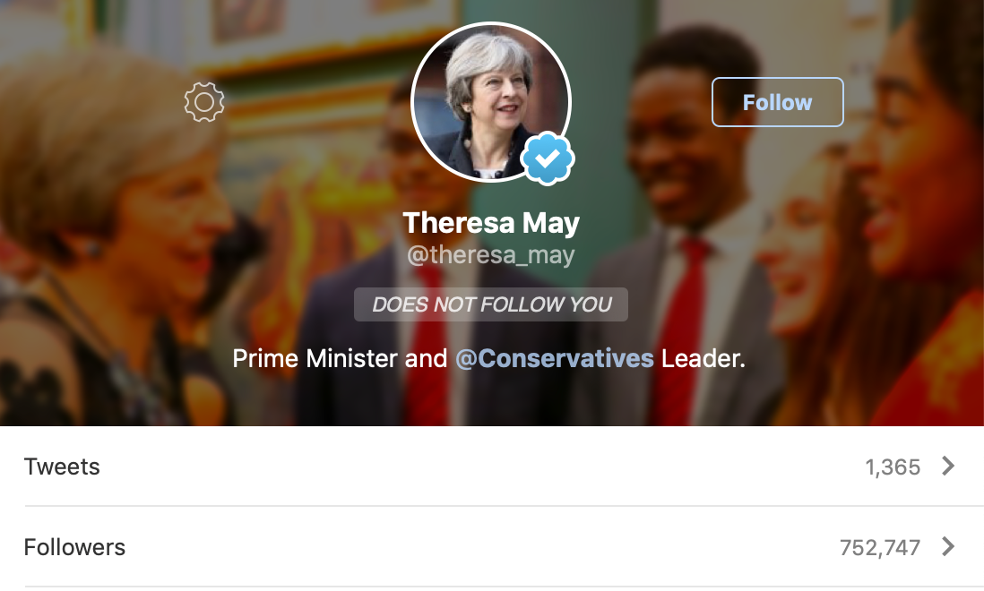
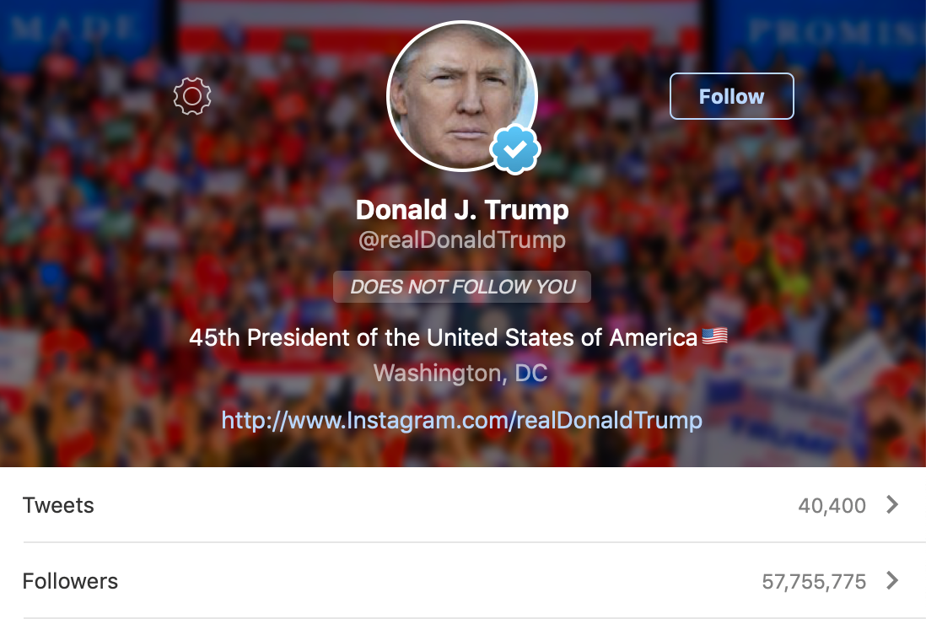
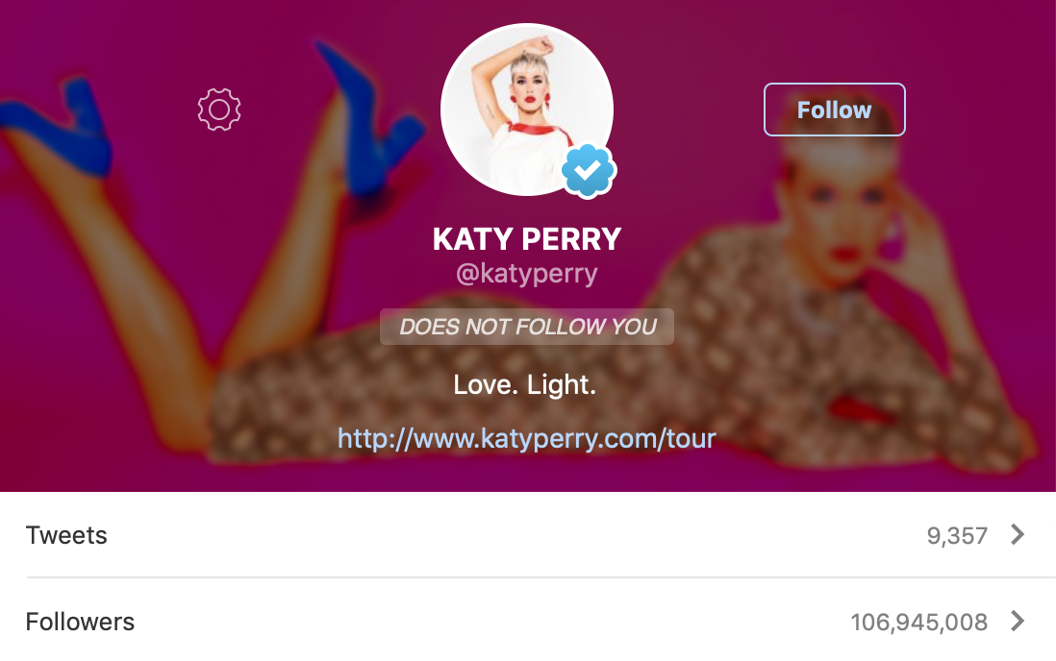
EVOLUTION OF INFORMATION
Notes:
We’re now in the age of social media. The printing press introduced the idea of mass communication, and now social media has taken it full circle: Today, anyone in the world can originate a message that can be amplified and received by everyone, on a huge global scale. In the 1980s you needed to be the President to reach large segments of the U.S. populace. In 2019 Katy Perry can reach twice as many people as the President and 50 times the number of people the the former Prime Minister of Britain could reach.
Many of the Internet pioneers will tell you that they started their projects with the lofty goal of creating a global “town square.” They wanted everyone to be enabled and have a voice. The good news is that it worked. The bad news is…well, that it worked. The power of mass influence now potentially belongs to anyone, and the effects can impact nations—or even global corporations.
Throughout the history of technology, we have continued to repeat the same mistake. We continue to develop and introduce new technology and communications systems without considering how they might be abused and distorted. With social networks we are seeing, once again, that layering security on top does not work. We must consider how our products and services will be abused and build in baseline protections before introducing them to the world.

Slide 12
SO THE POWER OF THE NATION-STATE BELONGS TO THE INDIVIDUAL

Slide 13
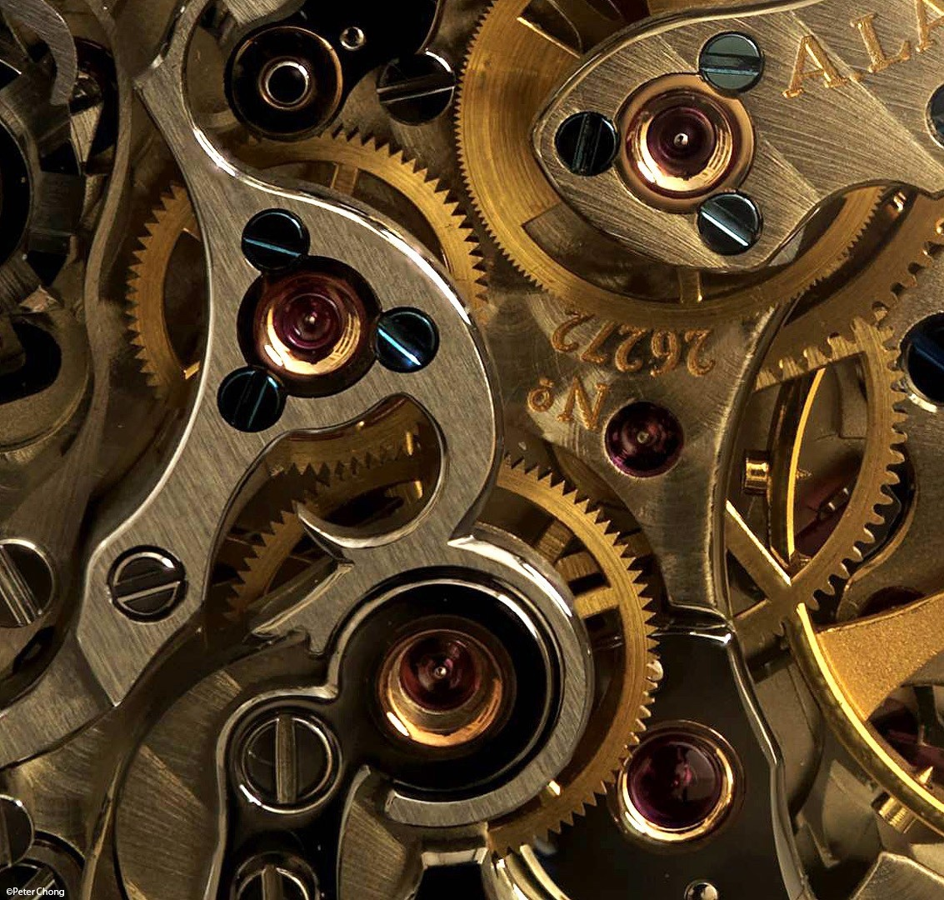
MECHANISMS OF INFLUENCE
All warfare is based on deception.
Sun Tzu
All cyberspace operations are based on influence.
- Pablo Breuer
Notes:
With that integrated view in mind, we will now give you a very brief introduction to the strategies, tactics, techniques, and procedures that allow an individual or small group to have an effect on a global scale. We will be combining principles and jargon from cybersecurity, psychology, sociology, and even political economics. Our goal is not just to share facts, but also to give you a taste of what it feels like to think in the language of socio-technical security. The ultimate goal is always some kind of mass population influence, so we will start in the realm of social psychology.

Slide 14
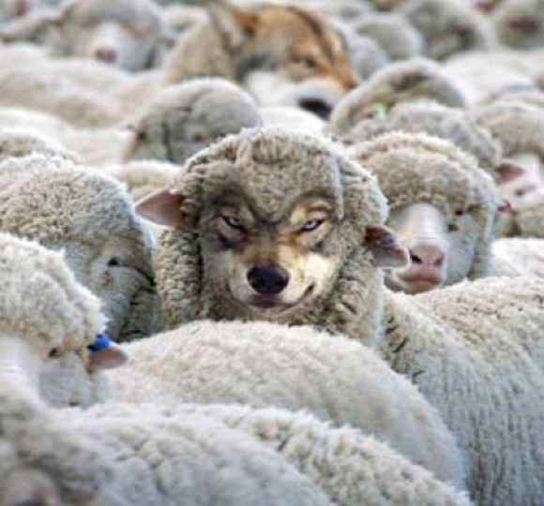
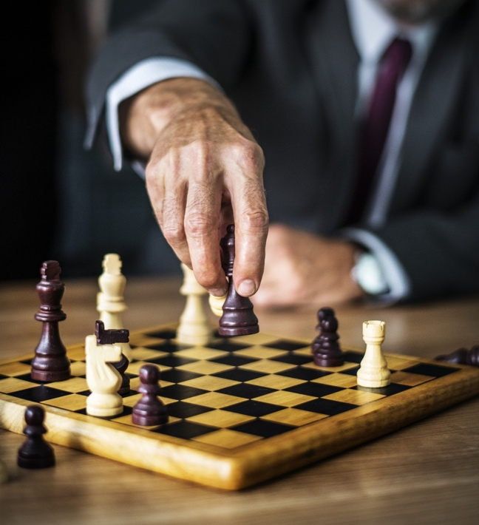
TYPES OF ACCOUNTS
Bots
Parody
Spoof
Camouflage
Deep cover
Takeover
Notes:
https://medium.com/@timboucher/adversarial-social-media-tactics-e8e9857fede4
Bots: Bulk purchase, mostly amplifiers, little-to-no original content
Parody: Clearly counterfeit account used to satirize or diminish image
Spoof: Counterfeit account which closely copies real account.
Camouflage: False account which mimics community of real accounts
Deep Cover: False account accepted as real for long periods of time
Takeover: Real account in control of adversary

Slide 15
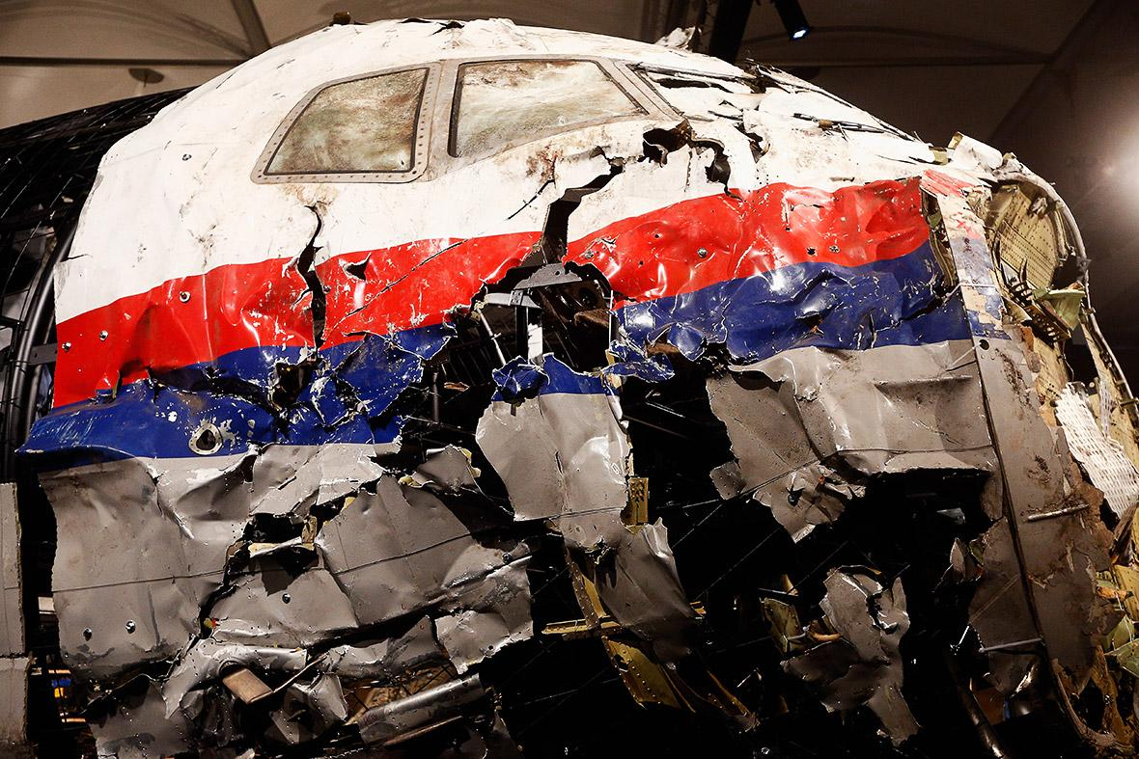
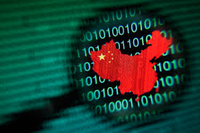
STRATEGIES
Distort
Divide
Distract
Dismiss
Dismay
Notes:
The social strategies for mass population influence can be divided into five categories: Distort, Distract, Dismay, Dismiss, and Divide.
•Distort the facts. We’re not invading the Ukraine; we’re rescuing/protecting ethnic Russians.
•Dismiss: Critics and uncomfortable facts. Make counter-accusations. We’ve seen this one used often by China. Every time the U.S. accuses China of stealing our intellectual property via illicit hacking, China retorts by first dismissing the accusation and then stating that they’re the targets of U.S. hacking.
•Distract from the main issue. MH-17 was a tragedy. Why is a commercial airliner flying over a war zone?
•Divide: Reduce trust, create confusion, and provoke populations. It’s not an accident when two groups at polar opposite ends of the political spectrum “magically” have competing events at the same time and place.
•Dismay: Ad-hominem – make personal attacks, insults and accusations. This one is particularly interesting because by even addressing these attacks, you lend them credence. Think about Pizzagate. Making a preposterous claim suggesting that political elites have a secret sex dungeon full of kids is very hard to defend against without lending the accusations credence.
•
------------------------------------------------------
Reference: Nimmo, Ben. 19 May 2015. “Anatomy of an Info-War: How Russia’s Propaganda Machine Works, and How to Counter it.” StopFake.org 01 December 2018<https://www.stopfake.org/en/anatomy-of-an-info-war-how-russia-s-propaganda-machine-works-and-how-to-counter-it/>
Social graph: Dr. Kate Starbird, via https://twitter.com/katestarbird/status/954805298652332032

Slide 16
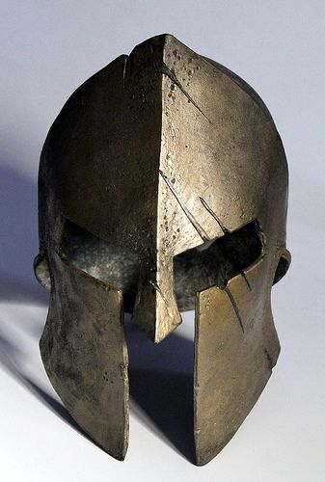
MITIGATIONS
The only defense against the world is a thorough knowledge of it.
- John Locke
Notes:
Everything we've said so far is describing the problem space: the techniques that attackers use to plan and execute influence campaigns. But we don’t want you to lose all hope: there are mitigations available, defensive frameworks, and even some defensive infrastructure is starting to be built. Artificial intelligence, machine learning, big data, and social network analysis have all been applied.
https://arxiv.org/pdf/1812.00315.pdf

Slide 17
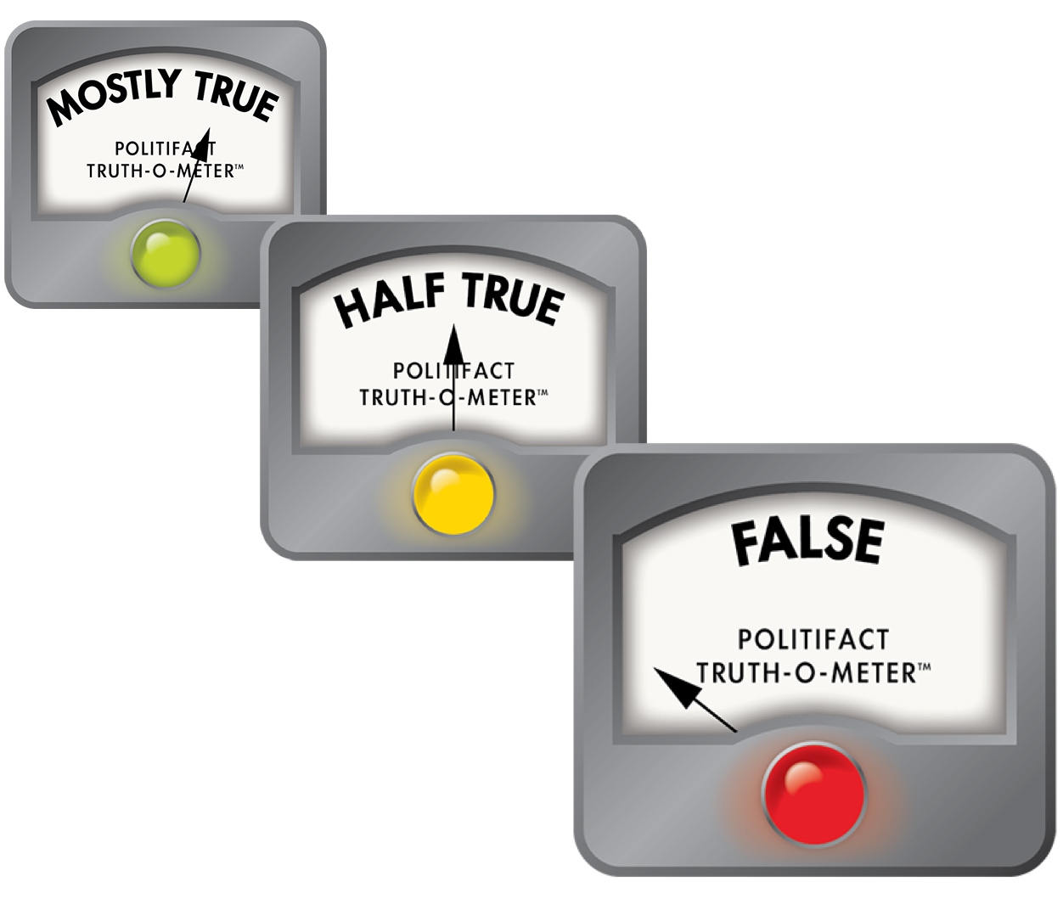
Previous Mitigation Strategies
Fact-based Detection
Manual (i.e. Snopes, Politifact)
Automated (Subject, Predicate, Object)
Open-world
Closed-world
Doesn’t address editorials
Notes:
Fact checking is the most obvious and pervasive method that’s currently used. There are two methods of fact-checking: manual and automatic.
Manual Fact checking: We all do this. We here a story and run to the all-knowing Google to verify a fact. Snopes and Politifact are two well known sources for verifying facts. We watch presidential debates and anxiously await for the news to show us the “truth-o-meters.”
Automated Fact checking: Is closer to what computer scientists would call a formal language. Any statement is broken down into subject, object, predicate triples (or 3-tuple) and compared against a model.
•Closed World: In closed world models, all new facts are assumed false until verified against our model of accepted facts. Epistemically, the causes problems as facts aren’t really “proven,” they are simply unrefuted.
•Open World: In an open-world model, all new tuples are accepted as true, unless they run afoul of a previously accepted fact. This leads to a different problem in that a falsehood can be accepted for a long time until specifically refuted.
•There is a further problem. Neither open-world nor closed-world models are capable of dealing with editorials or satire.

Slide 18
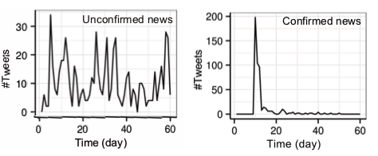
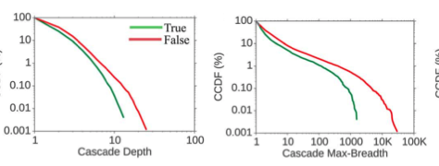
Previous Detection Strategies
Propagation-Based Detection
Hop-based cascade
Time-based cascade
Epidemic Diffusion Model
r_{c}
r_{c}
r_{f}
S
I
Notes:
Look at the top two graphs. The first represents “unconfirmed” news. Unconfirmed news is “rediscovered” because bots and other accounts attempting to conduct influence operations will re-amplify messages to keep them in the public awareness. By comparison, real news is introduced in the normal cycle, is accepted as true, and is not re-amplified beyond its initial peak.
Moving onto the bottom graphs, fake news spread farther, faster, and more widely than true news. There is a deliberate attempt to re-introduce the narrative to as wide an audience as possible. This leads to a broader cascade depth and breadth.
Every time a message is re-amplified, it will reach new audience members. Those members will comment, share, or like reaching other people that had previously not seen the message.
•Epidemic diffusion models: Are used by health professional to track infectious diseases. In this model:
•S is a subject (in the case, a person)
•I is a subject that has been “infected” and believe false information.
•Rc: Is the rate of contact a subject has with a piece of false information.
•Rf: Is the “infection” rate. The rate at which a person becomes “infected” with false information.
•Rc: Is the rate at which someone is “cured.” They no longer believe the false information. They address their own retweets, likes, etc. by deleting their original post or stating a change in position.
•The problem with this model is that we don’t understand the catalyst that forces a state change. We’re contacted by false information all the time. What was it about the last message that forced a change in belief?
Reference: Xinyi Zhou and Reza Zafarani. 2018. Fake News: A Survey of Research, Detection Methods, and Opportunities. ACM Comput. Surv. 1, 1 (December 2018), 40 pages.

Slide 19
ANALYSIS - CHALLENGES
Computational power
Speed of analysis
Lack of framework
Systems theory and emergence of characteristics
Cognitive friction
Cognitive dissonance
https://www.visualcapitalist.com/wp-content/uploads/2018/05/internet-minute-share2.jpg
Notes:
All of the existing models have their own unique challenges. They also have a lot of challenges in common.
•Computational Power: There are no more IP connected devices on the Internet than there are people on the planet. This is only going to get worse. When you look at the tremendous amount of information that traverses the Internet at any given point in time, you quickly realize that we will never have the computational power to verify all of it - regardless of the model used.
•Speed of Analysis: Even if we have the computational power to verify all information on the Internet,, it will take time. In that time, how many people will have seen and been infected by the false information? To how many people will they proliferate the message?
•Systems theory and emergence of characteristics: We don’t understand why any given tweet, post, or story “infects” a person with misinformation. System theory tells us that the whole is greater than the sum of its parts. What happens when someone is infected with misinformation and they’ve seen a post, a video, a news story, a blog, and heard a podcast all claiming the same “fact.” How much harder is it to “cure” a person now?
•Cognitive Dissonance: We tend to believe “facts” that are aligned with our bias, whether based on experience or belief. If misinformation plays to our bias, we’re far more likely to believe that misinformation than we are to believe a fact that disagrees with our bias.
•Cognitive Friction: Once someone has adopted a view, they’re entrenched. It’s much harder to convince someone that their current view is “wrong.” We have a social and psychological resistance to it.
•
•
https://www.visualcapitalist.com/wp-content/uploads/2018/05/internet-minute-share2.jpg

Slide 20
CONTENT CHALLENGES - New Media and Deep Fakes
Notes:
There are some content challenges. Much like the “War of the Worlds” phenomenon, we are more likely to believe messages from “authoritative” sources that confirm our existing beliefs. We tend to follow sources that agree with our cognitive bias and avoid dissenting opinions.
If you’re not familiar with that picture, a group called the “Yes Men” circulated this fake edition of the Washington Post in Washington DC’s Union Station in December 2018. It was found at newsstands in coffee shops, handed out, and otherwise available as people went to work in the DC area. Clues were left that this was not the real Washington Post, yet it was so convincing that the actual Washington Post felt a need to post that this was not a real edition through their official social media. This is the first time since World War II physical psychological operations products were distributed to the US populace. Had this been done by a foreign nation-state, it would have violated the principles of the Westphalian model of a nation-state and could have resulted in war.

Slide 21
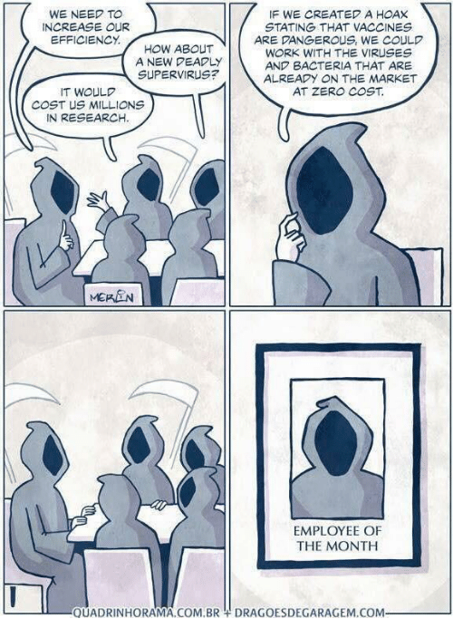
TOWARDS JOINED-UP RESPONSES
Creating a misinfosec response community
Notes:
Image: http://www.quadrinhorama.com.br/

Slide 22
MISINFOSEC COMMUNITIES
Industry
Academia
Media
Community
Government
Infosec

Slide 23
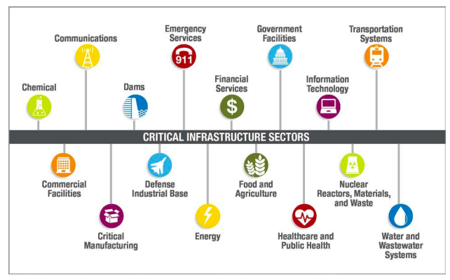
INTELLIGENCE SHARING AND COORDINATION BODIES
Notes:
Specifically, support to ideas for ISAO/ Interpol units. We can’t have things like misinformation Interpol without ways of sharing information quickly between organisations.
https://www.isao.org/information-sharing-groups/enrollment/
https://www.dhs.gov/cisa/information-sharing-and-analysis-organizations-isaos
image: https://www.dhs.gov/sites/default/files/publications/ISC-PPD-21-Implementation-White-Paper-2015-508.pdf

Slide 24
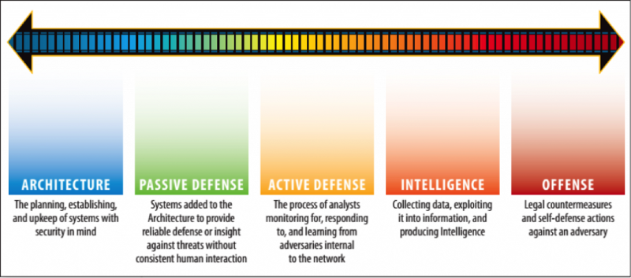
DESIGNING AND SHARING RESPONSES
Notes:
There are still a lot of bots out there, but tactics, techniques and procedures are changing rapidly: we’re starting to see an early-infosec-style split into script-kiddie style crude botnets and more carefully crafted responsive bots.
I’ve (SJT) been talking about misinformation for a while now. And in that time, there’s been a lot of “admiring the problem” and not so much action. But there is action. You just have to look for it. There’s work against financially-motivated misinformation at the architecture and passive defence levels - I(SJT) personally work half my time at the Global Disinformation Index, designing systems to estimate the probability of a domain containing financially-motivated misinformation, and have friends working hard against botnet spread.
Response against power-based misinformation generally needs to be faster, more coordinated, and has to take advantage of knowledge gained by many defenders across many different fields. Action there includes daily bomb alerts at the new IRA building. Macron’s team building email honeypots in case US election tactics were used against them too. The Baltic Elves joining up with local media. Botnet removal, but not real-time or across platforms. But we need a way to share the knowledge of what was tried, or worked against which tactics, to the people who can act at the time that they need to act.
Image: SANS sliding scale of cyber security
https://www.newyorker.com/magazine/2018/05/07/the-digital-vigilantes-who-hack-back

Slide 25
COMBINING DIFFERENT VIEWS OF MISINFORMATION
Information security (Gordon, Grugq, Rogers)
Information operations / influence operations (Lin)
A form of conflict (Singer, Gerasimov)
[A social problem]
[News source pollution]
Notes:
And they’re all using different models and terminologies to address the same issue

Slide 26
CREATING A COMMON LANGUAGE
“We use misinformation attack (and misinformation campaign) to refer to the deliberate promotion of false, misleading or mis-attributed information. Whilst these attacks occur in many venues (print, radio, etc), we focus on the creation, propagation and consumption of misinformation online. We are especially interested in misinformation designed to change beliefs in a large number of people.”
Notes:
The quote is from the CredCo paper on misinfosec standards. A mixed team of academics, government, industry from multiple disciplines took a long time to agree on this definition.

Slide 27
COMPONENTWISE UNDERSTANDING AND RESPONSE
Lingua Franca across communities
Defend/countermove against reused techniques, identify gaps in attacks
Assess defence tools & techniques
Plan for large-scale adaptive threats (hello, Machine Learning!)

Slide 28
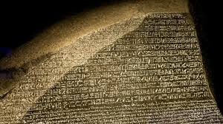
FRAMEWORKS AS A COMMON LANGUAGE
the infrastructure behind misinfosec and what we can do with it

Slide 29
MISINFORMATION PYRAMID
attacker
Campaigns
Incidents
Narratives
defender
Artifacts
Notes:
In this talk, we’re going to focus on power-motivated misinformation, using this handy graphic.
We have three main groups of people in this world: the creators of misinformation (‘attackers’), the people trying to counter them (‘defenders’), and the targets of the misinformation (‘populations’). Attackers create incidents (e.g. Macrongate), which often form part of longer-term campaigns (e.g. destabilize French politics). Human communication is generally at the level of stories, or narration: we tell each other stories about the world, as gists or memes. And to tell these stories, we need artefacts: the users, tweets, images etc that are visible in each attack. Whilst the attacker sees the whole of the pyramid from the top down, the defender usually sees it from the bottom up, working back from artefacts to understand incidents and campaigns, unless they’re lucky enough to have good insider information or intelligence. Most current misinformation work is at the artifact level, although there has been narrative (story) level work happening recently.
When you look at that pyramid, those layers aren’t just about information - they’re also about action.
We’ll revisit this pyramid again.

Slide 30
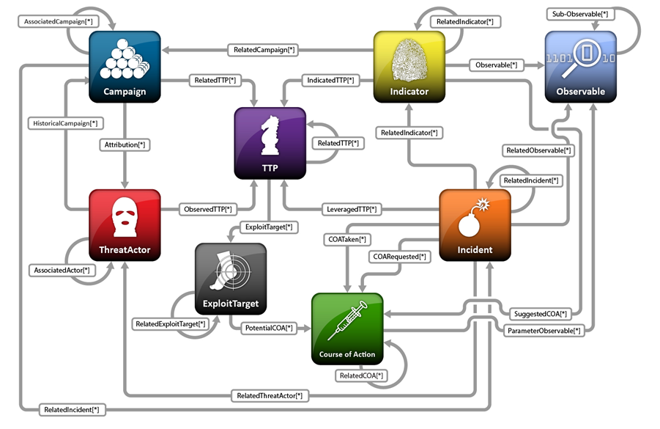
INFOSEC HAS THINGS WE CAN USE
Notes:
STIX (Structured Threat Information eXpression) model, used by government and industry

Slide 31
STAGE-BASED MODELS ARE USEFUL
RECON | WEAPONIZE | DELIVER | EXPLOIT | CONTROL | EXECUTE | MAINTAIN
Persistence | Privilege Escalation | Defense Evasion | Credential Access | Discovery | Lateral Movement | Execution | Collection | Exfiltration | Command and Control
Notes:
The cyber attack model (top), with its extension, the MITRE ATT&CK model (bottom) looked promising.
Misinformation has rapid feedback, can target quickly…
ATT&CK phases:
* Persistence – Any access, action, or configuration change to a system that gives an adversary a persistent presence on that system. Adversaries will often need to maintain access to systems through interruptions such as system restarts, loss of credentials, or other failures.
• Privilege Escalation – The result of techniques that cause an adversary to obtain a higher level of permissions on a system or network. Certain tools or actions require a higher level of privilege to work and are likely necessary at many points throughout a remote operation.
• Defense Evasion – Techniques an adversary may use for the purpose of evading detection or avoiding other defenses.
• Credential Access – Techniques resulting in the access of, or control over, system, domain, or service credentials that are used within an enterprise environment.
• Discovery – Techniques that allow an adversary to gain knowledge about a system and its internal network.
• Lateral Movement – Techniques that enable an adversary to access and control remote systems on a network. Often the next step for lateral movement is remote execution of tools introduced by an adversary.
• Execution – Techniques that result in execution of adversary-controlled code on a local or remote system.
• Collection – Techniques used to identify and gather information, such as sensitive files, from a target network prior to exfiltration.
• Exfiltration – Techniques and attributes that result or aid in an adversary removing files and information from a target network. This category also covers locations on a system or network where an adversary may look for information to exfiltrate.
• Command and Control – Techniques and attributes of how adversaries communicate with systems under their control within a target network. Examples include using legitimate protocols such as HTTP to carry C2 information.

Slide 32
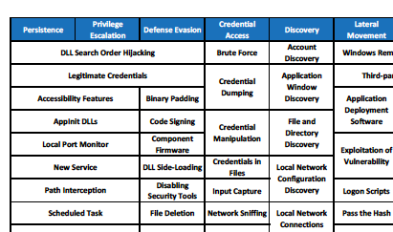
WE EXTENDED THE ATT&CK FRAMEWORK
Notes:
Mapping phases to techniques - really useful
Each Tactic stage has a pick-list of Techniques - really useful

Slide 33
POPULATING THE FRAMEWORK: HISTORICAL ANALYSIS
Campaigns
e.g. Internet Research Agency, 2016 US elections
Incidents
e.g. Columbia Chemicals
Failed attempts
e.g. Russia - France campaigns

Slide 34
HISTORICAL CATALOG: DATASHEET
Summary: Early Russian (IRA) “fake news” stories. Completely fabricated; very short lifespan.
Actor: probably IRA (source: recordedfuture)
Timeframe: Sept 11 2014 (1 day)
Presumed goals: test deployment
Artefacts: text messages, images, video
Related attacks: These were all well-produced fake news stories, promoted on Twitter to influencers through a single dominant hashtag -- #BPoilspilltsunami, #shockingmurderinatlanta,
Method:
Create messages. e.g. “A powerful explosion heard from miles away happened at a chemical plant in Centerville, Louisiana #ColumbianChemicals”
Post messages from fake twitter accounts; include handles of local and global influencers (journalists, media, politicians, e.g. @senjeffmerkley)
Amplify, by repeating messages on twitter via fake twitter accounts
Result: limited traction
Counters: None seen. Fake stories were debunked very quickly.

Slide 35
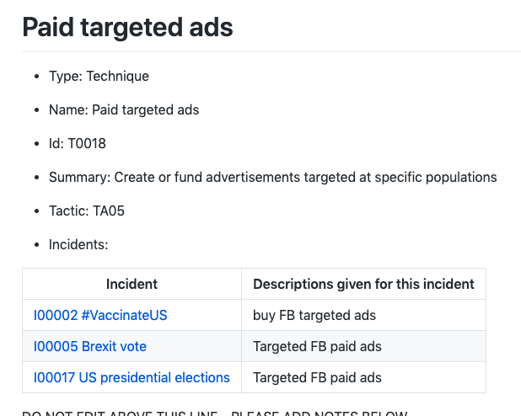
FEEDS INTO TECHNIQUES LIST
Notes:
STIX /TAXII works for this, makes sense
… and we have to start filling these out…

Slide 36
POPULATING TECHNIQUES: INCIDENT ANALYSIS
Top-down (strategic): info ops
What are misinformation creators likely to do? What, where, when, how, who, why?
What do we expect to see?
What responses and impediments to responses were there?
Bottom-up (tactical): data science
Unusual hashtag, trend, topic, platform activity?
Content from ‘known’ trollbots, 8/4chan, r/thedonald, RussiaToday etc
What are trackers getting excited about today?
Notes:
TODO: Ways, means, ends in here
Lots of secondary questions, e.g. what artifacts are they likely to leave when they do it?

Slide 37
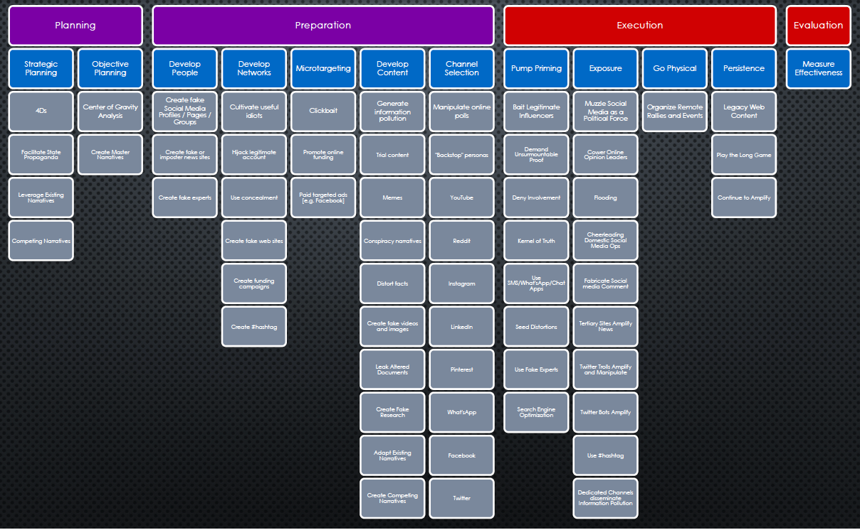
AMITT
Notes:
The MisinfosecWG team is writing a misinformation equivalent to the ATT&CK TTP framework. This is what we’re aiming at: a populated framework, where you can click on a technique and get details about what it is, who uses it, and which counters are available for it.

Slide 38
AMITT PHASES AND TACTIC STAGES
Planning | Strategic Planning
 | Objective Planning
Preparation | Develop People
 | Develop Networks
 | Microtargeting
 | Develop Content
 | Channel Selection
Execution | Pump Priming
 | Exposure
 | Go Physical
 | Persistence
Evaluation | Measure Effectiveness

Slide 39
AMITT STIX
Misinformation STIX | Description | Level | Infosec STIX
Report | communication to other responders | Communication | Report
Campaign | Longer attacks (Russia’s interference in the 2016 US elections is a “campaign”) | Strategy | Campaign
Incident | Shorter-duration attacks, often part of a campaign | Strategy | Intrusion Set
Course of Action | Response | Strategy | Course of Action
Identity | Actor (individual, group, organisation etc): creator, responder, target, useful idiot etc. | Strategy | Identity
Threat actor | Incident creator | Strategy | Threat Actor
Attack pattern | Technique used in incident (see framework for examples) | TTP | Attack pattern
Narrative | Malicious narrative (story, meme) | TTP | Malware
Tool | bot software, APIs, marketing tools | TTP | Tool
Observed Data | artefacts like messages, user accounts, etc | Artefact | Observed Data
Indicator | posting rates, follow rates etc | Artefact | Indicator
Vulnerability | Cognitive biases, community structural weakness etc | Vulnerability | Vulnerability

Slide 40
AMITT UPDATES AT http://misinfosec.org

Slide 41
Misinfosec: The Way Ahead
Continue to grow the coalition of the willing
Support the Cognitive Security ISAO
Contribute at misinfosec.org
Continue to build an alert structure (ISAC, US-CERT, Interpol, Industry, etc.)
Continue to refine TTPs and framework
STIX data science layer - connect to framework

Slide 42
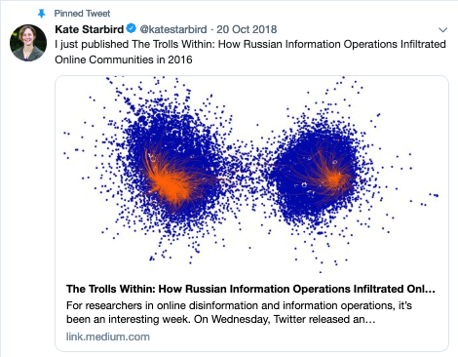
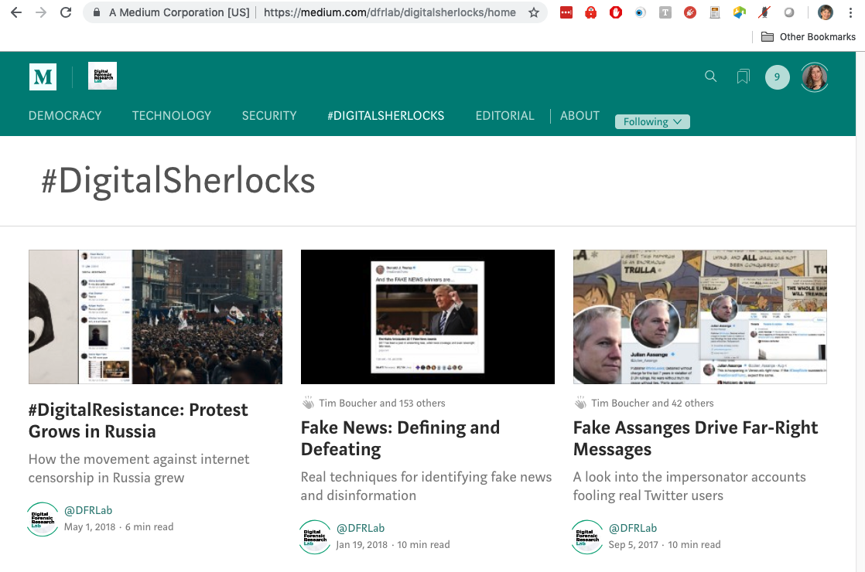
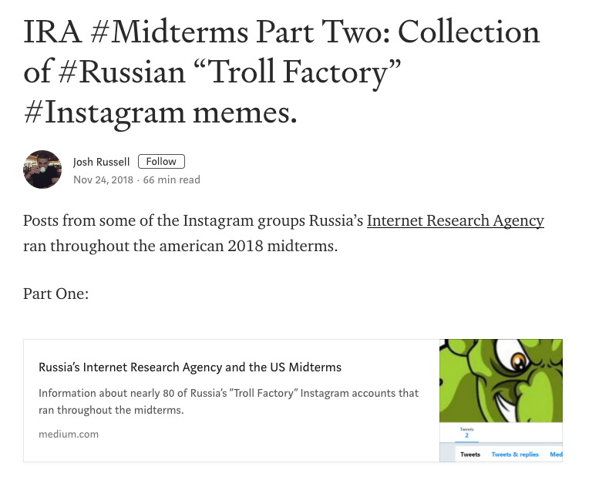
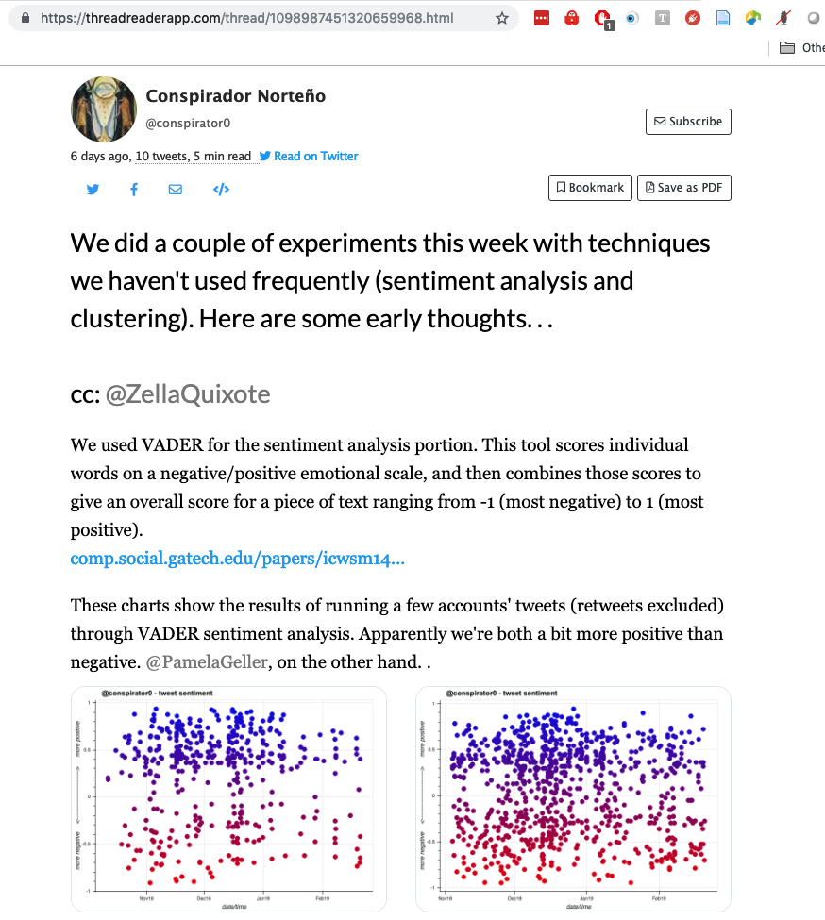
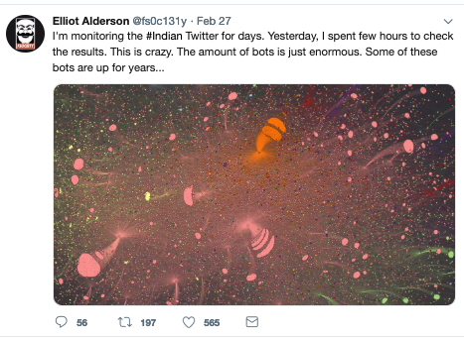
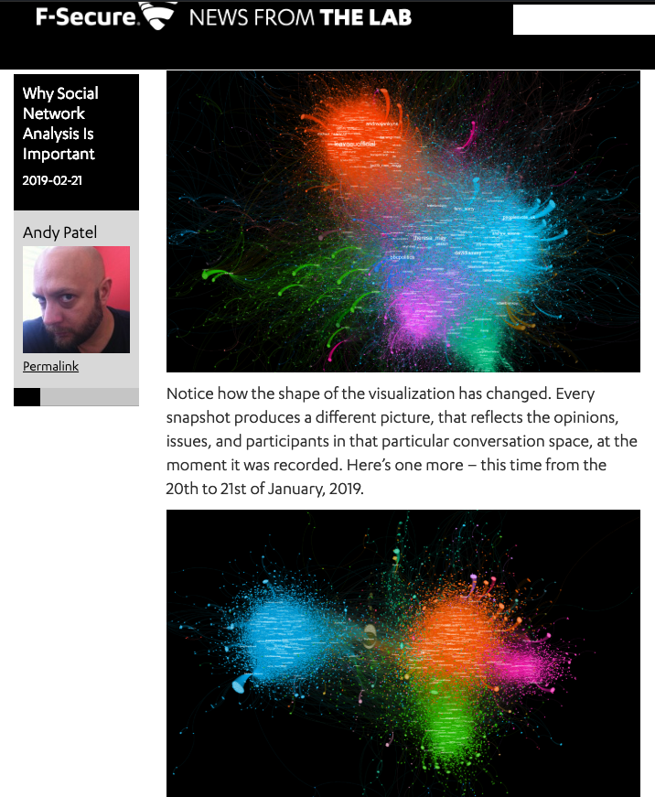
EXPERT TRACKERS
@katestarbird
#digitalsherlocks
@josh_emerson
@conspirator0
@fs0c131y
@r0zetta
Notes:
https://medium.com/s/story/the-trolls-within-how-russian-information-operations-infiltrated-online-communities-691fb969b9e4
https://medium.com/dfrlab/digitalsherlocks/home
https://medium.com/@josh_emerson/ira-midterms-part-two-collection-of-russian-troll-factory-instagram-memes-5b3492108aa6
https://twitter.com/conspirator0/status/1098987451320659968
https://twitter.com/r0zetta (Andy Patel)
@fs0c131y (Elliot Alderson)
https://www.iwr.ai/voterfraud/index.html

Slide 43
REFERENCES
A Room With a View. "Lord Haw Haw - Germany Calling." 04 May 2016. YouTube. 10 December 2018. <https://www.youtube.com/watch?v=yI3IjZ5Ut9g>.
Boucher, Tim. "Adversarial Social Media Tactics." 10 August 2018. Medium. 26 December 2018. <https://medium.com/@timboucher/adversarial-social-media-tactics-e8e9857fede4 >.
Bruce, Schneier. "Information Attacks Against Democracy." 21 November 2018. Schneier on Security. 15 January 2019. <https://www.schneier.com/blog/archives/2018/11/information_att.html?fbclid=IwAR3l6zYAWUmzdkPwWbX6Kl-mbKPRG2gS25E5sSch_5celRUHfEaNTGerIRU>.
Buzzfeed Video. "You Won't Believe What Obama Says in This Video." 17 April 2018. YouTube. 04 December 2018. <https://youtu.be/cQ54GDm1eL0 >.
Visual Capitalist. Visual Capitalist. 14 May 2018. 25 January 2019. <https://www.visualcapitalist.com/wp-content/uploads/2018/05/internet-minute-share2.jpg >.
Wahrheitsbewegung . "Obama erklärt in kürze die Neue Welt Ordnung 2016 ^^." 26 May 2014. YouTube. 04 December 2018. <https://www.youtube.com/watch?v=YfRtbIQ1kTw&feature=youtu.be>.
Zou, XinyI and Zafarani, Reza. "Fake News: A Survey of Research, Detection Methods, and Opportunities." 2 December 2018. Cornell arXiv. Document. 20 January 2019. <https://arxiv.org/pdf/1812.00315.pdf>.

Slide 44
THANK YOU
Sara “SJ” Terp
Bodacea Light Industries
sarajterp@gmail.com
@bodaceacat
CDR Pablo C. Breuer
U.S. Special Operations Command / SOFWERX
Pablo.Breuer@sofwerx.org
@Ngree_H0bit

