Slide 1
Member Driven. Member Focused.

Slide 2
Background
Your Invitation:
Join The National Council of Registered ISAOs
Best Practices
Advocacy
Member Benefits

Slide 3
Get Involved
Matt Gardner, CalCISO (Chair)
Nick Sturgeon, (Membership Chair)
Dale Nordenberg MD, MDISS (Treasurer)
Honorable Stuart M. Gerson, Epstein Becker Green (Policy Chair)
Carl Anderson, HITRUST
Frank Grimmelmann, Arizona Cyber Threat Response Alliance (ACTRA)
Allen Schreffler, LMI
Notes:
Rachel Thomas, Senior VP Operations & Policy at Trustworthy Accountability Group (TAG)

Slide 4
Peer Exchange
Best Practices

Slide 5
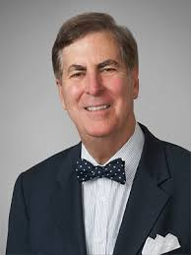
Peer Exchange
Best Practices
September 25th Webinar:
Model State Legislation
Featuring Stuart Gerson

Slide 6
Member Benefits
Programs that save time and money:
Insurance
Office supplies
Employee benefits
Career services
Technology solutions

Slide 7
Join Us!
We’re ready! Are you?
Join NCRI today. Find our table at IISC.
Contact:
Matt Gardner
mgardner@californiatechnology.org

