Slide 1

A Hybrid Model ISAO
James Jaeger
Arete Advisors
jjager@areteadvisorsinc.com
Kevin Baker
Westfield Insurance
KevinBaker@westfieldgrp.com

Slide 2
Objectives
A perspective on how industries using a non-employee workforce, in this case independent insurance agencies, can still positively affect their risk position while preserving their traditional relationships. Answers to some basic questions regarding how nontechnical work forces can provide valuable security intelligence to an ISAO in an automated fashion, as well as through manual tasks which bring immediate value to them, such as phishing sandbox services, and how that can jump start participation.
Reveal the risk reduction in the industry using the independent workforce
Reveal the benefits provided to the independent affinity group
  The well-known benefits of information sharing
  The benefits provided through the hybrid model
  Hybrid model ISAO provides a modified managed security service

Slide 3
Presentation Overview
Who we are & how we got here (Westfield/WAA/Arete)
  Some situational history in the development of the hybrid model
Problem characterization of the affinity group
  Independent insurance agent (could be independent distributor, etc.)
  Overcoming the inherent business competition dynamic with anonymity
Problem of affinity group as non-technical participants
  Non-participation drivers
  How do we overcome non-participation of non-technical members
Initiating participation (priming the pump) with technical services
  Endpoint protection (transparent participation in security intelligence)
  Phishing Sandbox service (solve a business problem)
Information sharing related to the affinity group
  What has happened, what should be done, what is required, what the road ahead should look like

Slide 4
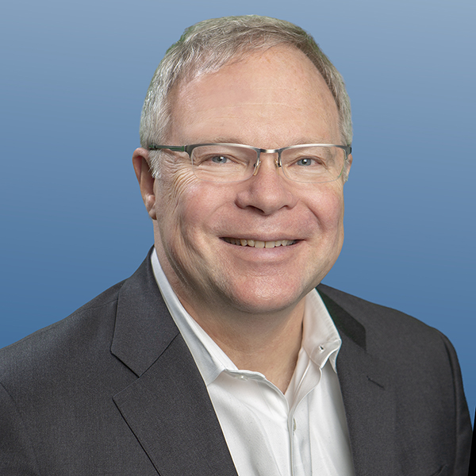
Jim Jaeger
President and Cyber Security Strategist
Arete Advisors
Former Brigadier General, US Air Force. Military service includes: Dir. of Intelligence (J2) U.S. Atlantic Command, Assist. Deputy Dir. of Ops at the National Security Agency, and Commander of the Air Force Technical Applications Center
Previously Vice President of Cyber Services and Chief Cyber Strategist for Fidelis
Managed the Network Defense and Forensics business at General Dynamics, including the Digital Forensics Lab
Supported the DoD Cyber Crime Center (DC3), the Defense Computer Forensics Lab and the Defense Cyber Crime Institute
Created GD information assurance and critical infrastructure protection group, which developed a wide variety of information assurance tools, including the Air Force’s intrusion detection infrastructure
Rhode Island Governor Gina Raimondo recently appointed Jim to the state’s Cyber Commission

Slide 5
Kevin Baker
CISSP-ISSMP, CRISC, CISA
Westfield Insurance
A 20-year veteran of the security industry, Kevin Baker has been a leader in the technical aspects of information security. Currently, Westfield’s Chief Information Security Officer, Baker integrates necessary toolsets managing security architecture and operations, providing business focused solutions for identity and access governance, regulatory compliance, and third-party risk.

Slide 6
Westfield Had a Risk Problem to Solve…
Exclusive use of Independent Agents, non-employees, yet they have credentials to sensitive internal systems
We recognized the precarious position of our independent agents
  Very basic or non-existent security program and little expertise
  Six security incidents at agent locations, some difficult conversations
We began thinking about how to affect our agents positively
  Education, particularly on social engineering
  We got in front of them whenever we could to begin the security conversation
  We are publishing articles with security viewpoints and practical advice
How could we make the best security resources available to our agents in a cost-effective way?

Slide 7
The Problem from the Agents Perspective
Some may be resistant to the message that cybersecurity is important
If this is such a problem, why don’t I hear about it from other agents?
  Independent agents sell for multiple carriers and are not inclined to share any bad experiences regarding security problems with any one carrier
  Independent agents are in competition with one another and are not inclined to share bad experiences with one another
  This results in a conspiracy of silence that obfuscates the peril
Overcoming the inherent mistrust of the Carrier and other Agents by providing anonymity within the ISAO

Slide 8
The Problem from the Agents Perspective
  Adoption of an information sharing economy is challenging, particularly in a start up situation
  Even when sensitive to the need for good cybersecurity agents struggled with believing they have something of value to share
  Lack of understanding of cybersecurity clouds the value proposition
  Solving the tendency for non-participation with actions that provide immediate value

Slide 9
A Hybrid Model
ISAO as a 501 c 6 non-profit with a tax-deductible membership fee
All services are provided by a qualified third-party
Proactive Security Services that provide security intelligence and solve problems
  Cloud based AI driven end point security
  Phishing sandbox
Standard Information Sharing Services
Compliance & Regulatory Guidance
Security Help Desk
Incident Response Hotline

Slide 10
A Hybrid Model
Getting buy-in by solving a common problem
  Phishing, ransomware and the normal speed of business
  New Regulatory Demands
      Third party questionnaires, written information security programs
  Gaining expertise in selling cyber-insurance as part of their risk management practice
  Possibly even extending the ISAO to their cyber customer base, reducing the risk that they will file a claim
  Using an independent Third Party to provide services & an abstraction layer between Agency and Carrier – Arete Advisors
  Hybrid model ISAO provides a modified managed security service

Slide 11
What are the Possibilities?
Who is best suited to understand the needs of the group?
  Generic Managed Services Providers?
  Tool centric security vendors?
Stakeholders
  Industries which use a non-employee workforce
Professionally based affinity groups:
  Independent Distributers
  Independent Financial Advisors
  Medical professions
  Legal professions

Slide 12
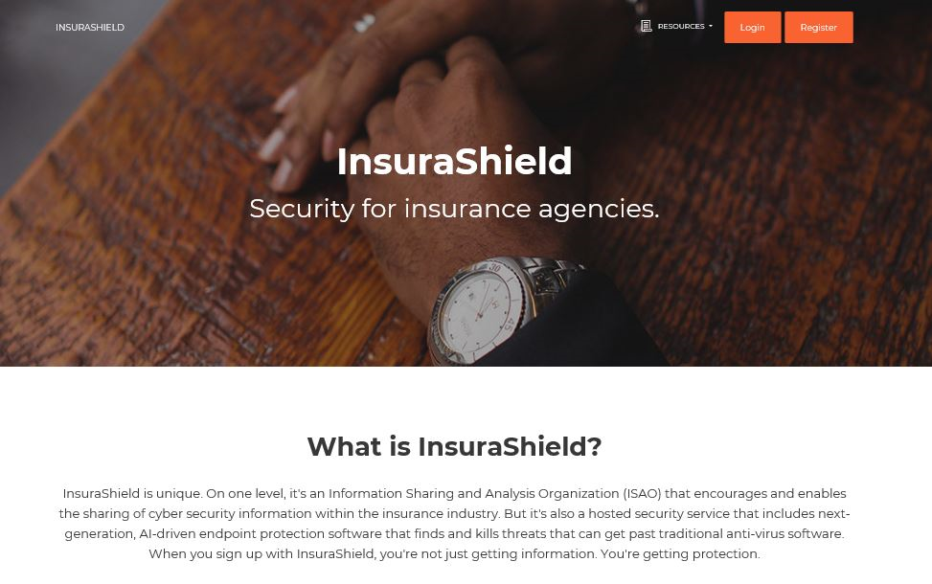

Slide 13
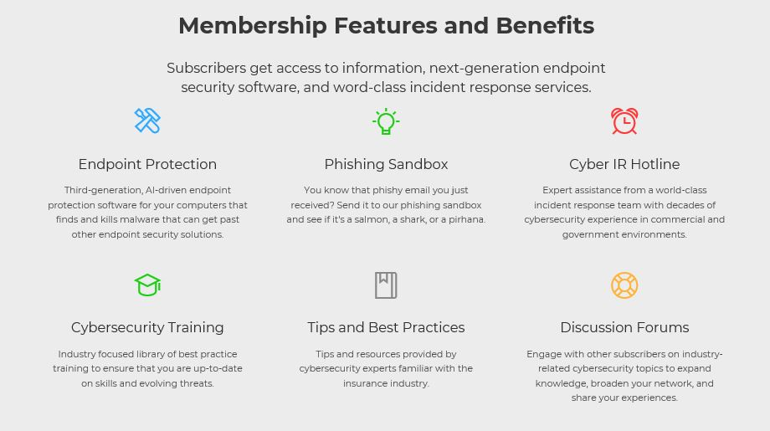

Slide 14
Questions?

