Slide 1
Shareable Workflows
August 22, 2019
Presenters from The Johns Hopkins Applied Physics Laboratory:
Mr. Nam Le, IACD Integration Team Lead
Ms. Karin Marr, Shareable Defense Measures Task Lead

Slide 2
Brief Explanation of IACD
Nam Le (nam.le@jhuapl.edu)

Slide 3




Who is IACD?
Integrated Adaptive Cyber Defense is an initiative hosted by the Johns Hopkins University Applied Physics Laboratory (JHU/APL) under the sponsorship of the National Security Agency (NSA) and the Department of Homeland Security (DHS).
Our goal is to dramatically change the timeline and effectiveness of cyber defense via integration, automation, and information sharing.

Slide 4
We have to Change the Game
Asymmetric Advantage to the Attackers:
Attackers share tools, techniques & vulnerabilities
Automation of the attack vs. manual defense
Attackers able to re-use tools and techniques across multiple targets
Cyber-attack response times are too slow:
Human in the loop, manually intensive processes
Limited analyst time
Large numbers of cyber events never analyzed
We aren’t controlling the space or the outcomes
Critical to Success:
Private sector and user community engagement ensuring
market-sustainable path towards automation and interoperability

Slide 5





What is IACD?
IACD defines a strategy and framework to adopt an extensible, adaptive, COTS-based approach
Plug-and-Play
Interoperability & Automation
Bring Your Own Enterprise
Information Sharing
Integrated Adaptive Cyber Defense:
an ecosystem because there are no silver bullets

Slide 6

IACD Approach to Influence Cyber Community
Experimentation & Prototyping
“Prove it Works”
Interoperability Specifications & Adoption Support
“Make It Work For Vendors”
Shareable Playbooks & Implementation Guides
“Make It Work For Defenders”
Pilots & Deployments
“Prove it Scales”
Community Reach
Technical Credibility
  © 2017 by The Johns Hopkins Applied Physics Laboratory. Material is made available under the Creative Commons Attribution 4.0 International License.

Slide 7
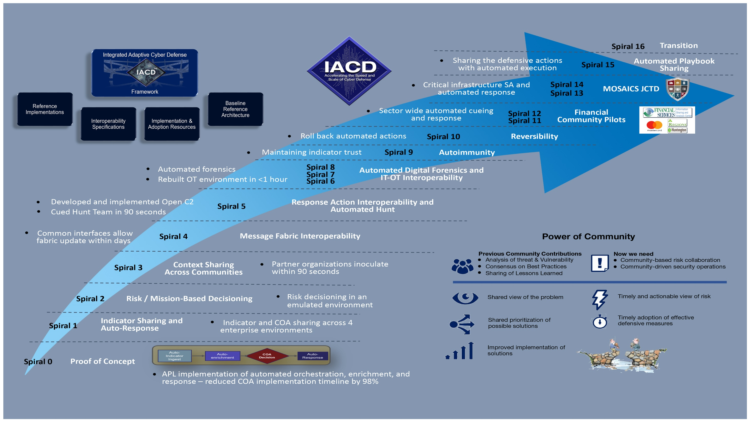

Slide 8
Shareable Workflows
Karin Marr (karin.marr@jhuapl.edu)

Slide 9
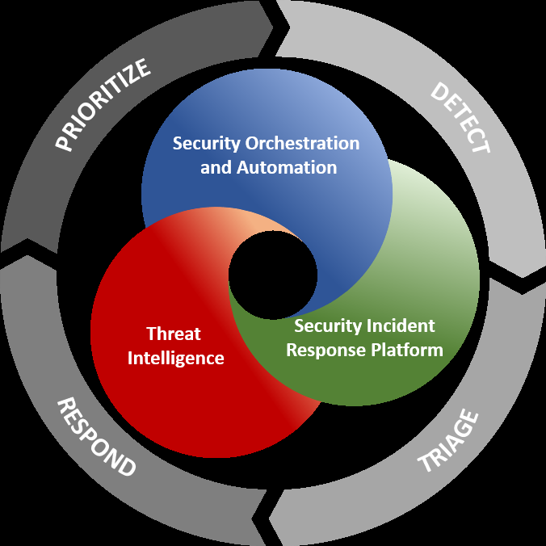





Security Orchestration, Automation and Response
(SOAR)
Security Automation provides immediate and measurable increases in the efficiency and consistency of operational processes.
Security Orchestration provides organizations a way to maximize existing investments, often resulting in an increase in capability or capacity.
  SOAR can provide sustainable and managed implementation of security automation
[SOAR] enables collection of security threat data and alerts from various organizational sources, where analysis and triage can be performed by both human and machine power to help define, prioritize and drive response activities according to a standard workflow
(Gartner, Inc)
Example:
According to an Enterprise Management Association survey, small to large businesses triage about 500 severe alerts per day
5 analysts can manually triage approximately 60 alerts a day.
440 severe alerts each day are ignored
After implementing SOAR, those same 5 analysts can triage 625 alerts daily
Examples of SOAR vendors:

Slide 10


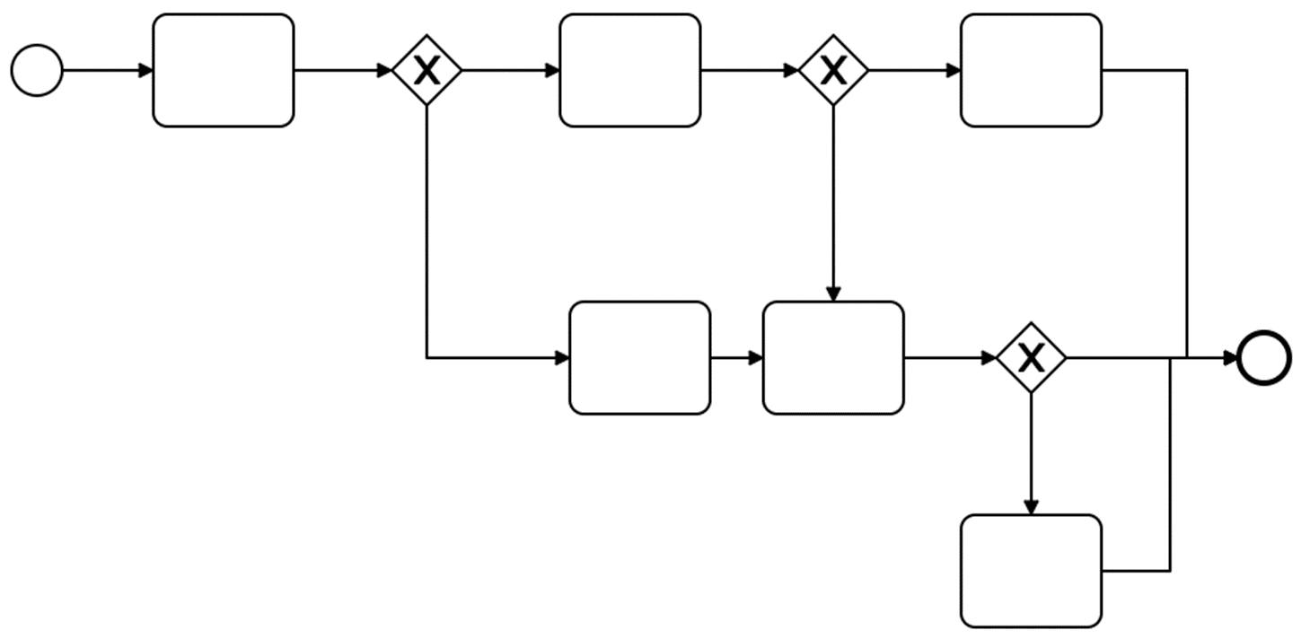
Maturation of Automation with SOAR Platforms
PLATFORM A
PLATFORM B
X
Maturation of SOAR platform marketplace is increasing the speed that organizations can respond to IOCs and manage their IT environments.
SOAR platforms operate by running documented processes.
They allow for consistent and repeatable application of an organization’s policy and procedures in response to a trigger.
Many SOAR platforms utilize workflow formats that are proprietary. Shareable workflows lead to greater adoption of community best practices as well as reductions in the time and financial capital to implement and maintain orchestration operation.

Slide 11
Objectives for Shareable Workflows
Demonstrate shareable defense measures using today’s capability that makes the information provided more actionable by default and the content more valuable and usable for the network defenders
What does Shareable Workflows promote?
  Machine to machine exchange of reusable defense measures
  Internal organizational technology deployment to support orchestration and automation
  Organizational operations and governance structure updates to enable tailoring
  Trust in automation
  Non-proprietary open source standards (ultimately vendor independent of IT cyber systems)

Slide 12
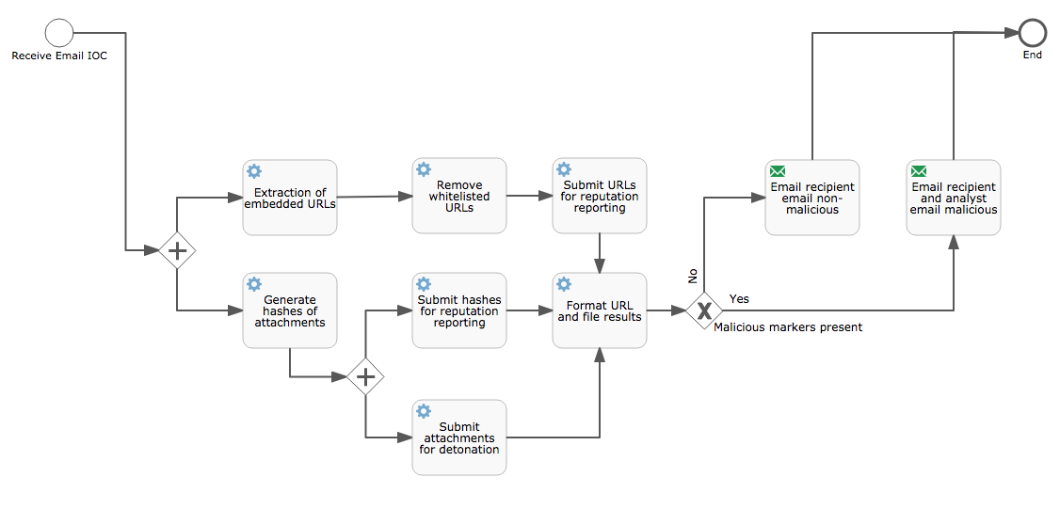
Definitions for This Brief
These definitions are defined by IACD and can be found at: https://www.iacdautomate.org/playbook-and-workflow-examples
Playbook
  Process oriented steps with human understandable actions
  Defines possible responses to cyber-event or other defined trigger conditions (e.g., best practices)
  Generic for broad applicability while detailed enough to meet specific situations
Workflow
  Originates from a playbook enabling automation of the procedures
  Machine understandable codification of playbooks including conditional statements
  Orchestration services execute workflows, interfacing with the other orchestration services and humans as necessary
  Workflows are machine-to-machine shareable and human editable
SOAR Platforms often refer to their local instance workflows as Playbooks
This brief calls them workflows (as per IACD definition)
We will not be talking about IACD Playbooks (per IACD definition)

Slide 13
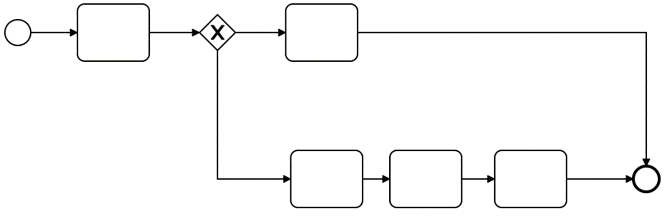
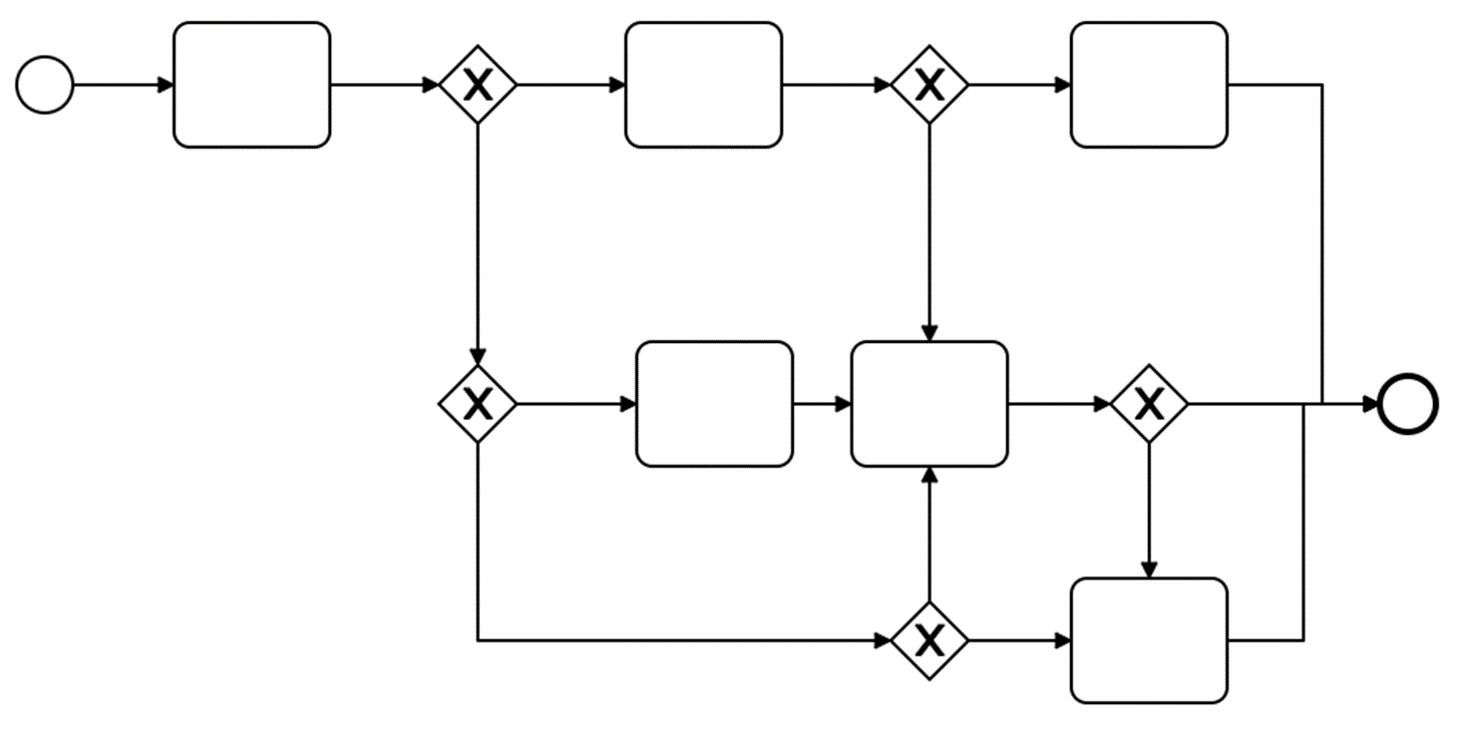
Development of Shared Workflows
High-level workflow containing key activities in response to a trigger condition (e.g. IOC, time interval)
Intended to be modified with addition/removal
of activities, and inclusion of logic per
organization’s business policies and procedures
Human readable and machine consumable
using XML output
BPMN XML files are ingestible by all
BPMN tools
SOAR platform tools require capability to ingest or convert XML
  Without a conversion script, an analyst would need to manually recreate the workflow in their SOAR platform
Shared (Reference) Workflow
Organization A
Organization B

Slide 14
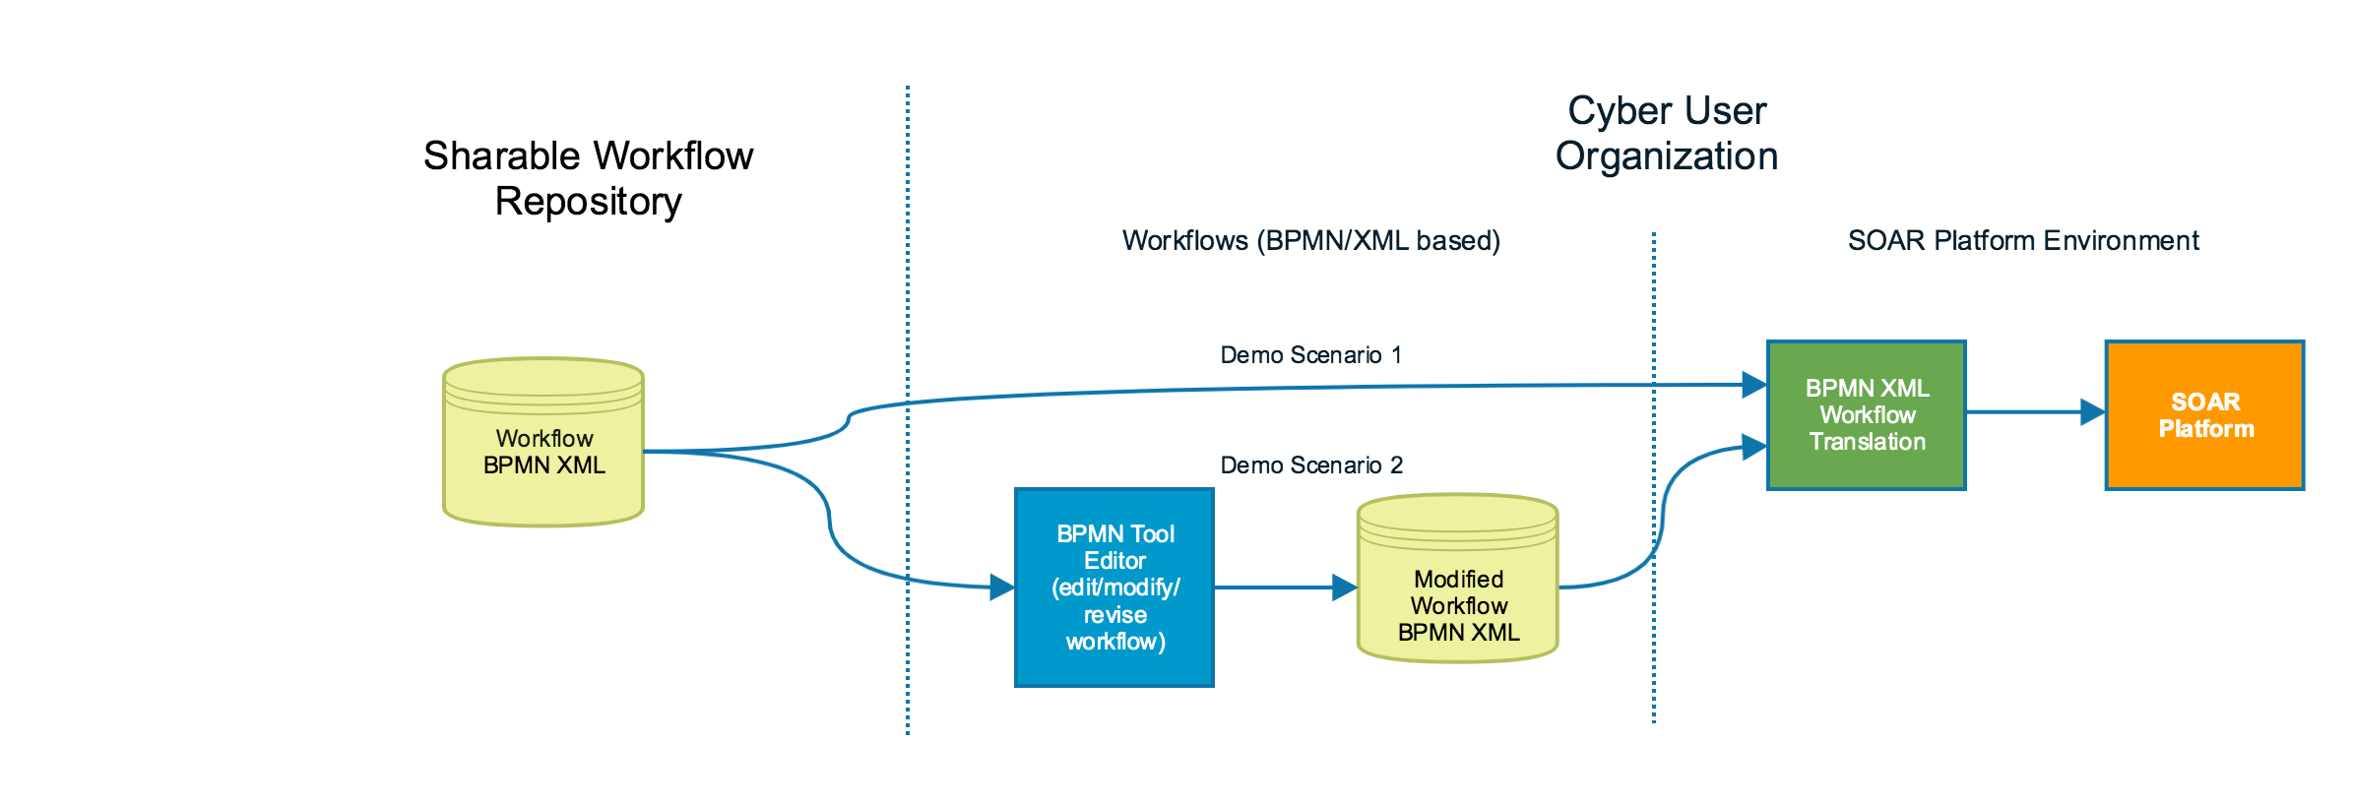
Overview of Ingestion of Shareable Workflows
Can ingest straight into the SOAR platform or
Use a BPMN standard
Advantages:
  Using BPMN as a standard and encouraging the SOAR community to understand BPMN output (XML) eliminates the challenges of sharing workflows between SOAR platforms
  Creates a database of shareable workflows that can be shared amongst common sectors
  Easier to modify globally when practices or policies change (especially for big organizations)

Slide 15



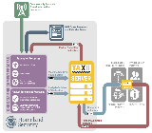

Demo Using BPMN Tool and SOAR Platform
Low Regret Workflow
Consumer 1
2
Low Regret Workflow
Cybersponse
Flowable
(BPMN)
3
XML
JSON
Consumer 1 Environment
5
Response
Block
IP
Ingest, Process & Store IOC
Retrieve
IOC
1
Ref Workflow
)
)
)
)
4
)
IOC
Risk Averse Workflow
AIS
Consumer 2
2
Ingest, Process & Store IOC
Demisto
Retrieve
Risk Averse Workflow
Camunda
(BPMN)
IOC
Consumer 2 Environment
5
Response
Create Ticket
XML
3
YAML
1
2
3
4
5
A shareable (reference) IOC BPMN/XML workflow has been created and made available to the consumers
Consumers download and ingest the BPMN/XML workflow into their own BPMN tool to tailor it to their organization’s own security & business policies (e.g. low regret or risk averse)
The modified BPMN/XML workflow is ingested by each of the Consumers SOAR platform and translated into their respective ingestible formats (e.g., JSON, YAML) to create a local instance.
Consumer ingests, processes, and stores IOCs from a DHS AIS feed.
The local instances are triggered by IOC receipt and each consumer executes the local instance workflow resulting in different response actions that are acceptable to their security & business policies.

Slide 16
Launch Demo
(can be found at: https://www.youtube.com/watch?v=sG1S3BIpqrM)

Slide 17
Shareable Workflow Challenges
Limitations based on SOAR platform workflow design
  Some saves more time for the analyst than others
  The need to adopt BPMN as a standard ingestion (XML)
Uncertain how soon industry will adopt
  Taking proprietary solutions to open solutions (think OpenC2)
Responsibility for creating & maintaining workflow repository
  Resources required
  Certification and validation must be established
BPMN is new to the cyber world
  Possible learning curve

Slide 18
Shareable Workflow Impacts
Trust in automation and orchestration to reduce time-consuming manual activities
Detect and respond to attacks before they have impact on critical missions
Repeatable procedures to share information with other organizations
Greater data enrichment of workflows with OpenC2 on horizon, reducing amount of work needed to implement in SOAR Platforms
Common workflow format shared with organizations regardless of SOAR platform
Potential to expand SOAR platform adoption and automation
Information provided becomes more actionable by default and content more valuable and usable for the network defenders

Slide 19
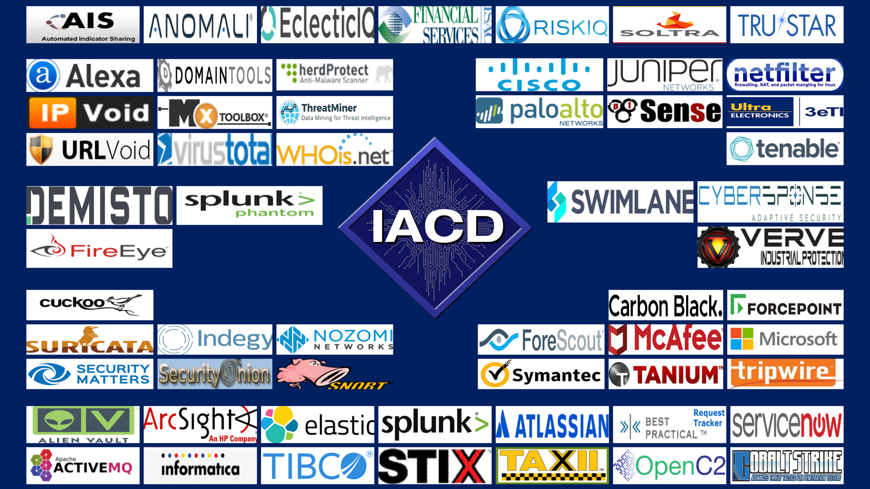
Next Steps
Engage additional SOAR platform vendors in supporting shareable workflows
Employ OpenC2
Use the community vendor space to grow the concept
Engage standards bodies and consortiums
Find the body who wants to be responsible for Certification & Accreditation

Slide 20
Questions?

