Slide 1
Infragard national 2019 Strategic direction & plans
Engaging InfraGard Communities
Gary Gardner, Chairman
Notes:
Presentation slide for courses, classes, lectures et al.

Slide 2
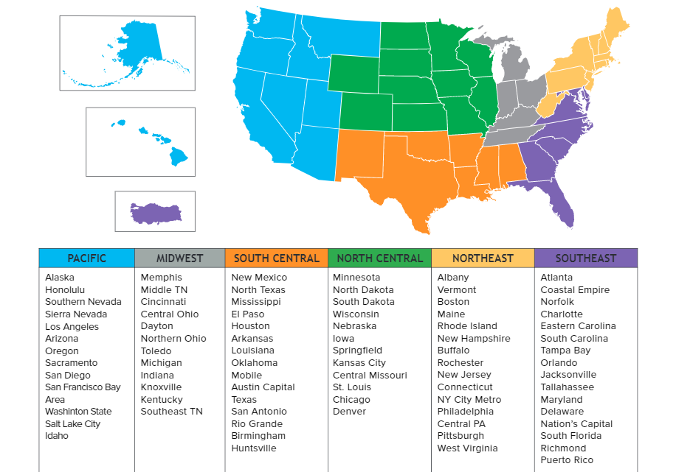
Current Status of InfraGard
78 Chapters/IMAs
6 Regions
National Board
67,000+ members

Slide 3
InfraGard Helps the FBI to…
(and other Government Agencies)
Prevent, detect, and investigate threats impacting critical infrastructure and/or national security
Better understand emerging trends
Foster crime prevention initiatives
Promote the exchange of ideas
Build key contacts within local communities and the public and private sectors
Alert citizens to threats and vulnerabilities
Facilitate peer-to-peer collaboration and information sharing
Notes:
3

Slide 4
How is InfraGard engaging with our communities?
We have regular local meetings for educating our members
FBI & DHS interaction locally
Our local chapters hold summits/symposiums/Conferences
A national program geared toward our communities representing the 16 Critical Infrastructures, – the National Sector Security & Resilience Program locally administered through Sector Chief’s for the primary sectors
Expanded engagement with local & state Fusion Centers - MOU
We have a national portal that provides daily notifications
FBI Private Sector Daily Digests
Forums for member interactions locally, regionally, nationally
Email, Library, Past webinars
National & Regional Conferences & Summits
Monthly webinars on timely topics
We engage other organizations like the ISAO

Slide 5
How our communities engage with InfraGard?
First join! At www.infragard.org
Attend meetings & support local programs, volunteer to help
Go on the portal regularly, learn and take action to protect your families, businesses, communities and Nation & make them more resilient
Get involved in the Sector program that represents your sector or sectors
Take our Infrastructures serious & work to protect them and make them more resilient

Slide 6
2019 Strategic Plan
2 Components:
INMA/IMA Program Management
InfraGard National Programs
Goals
Serve IMAs and members
Enhance Education & Information Sharing
Sync mission goals nationally with the FBI
Assist IMAs in syncing mission goals with their local FBI
Professionalize the organization
Create sustainability in programs and funding

Slide 7
2019 Strategic Plan: INMA/IMA Program Management
INMA Management/Operations
Staffing
3 new hires this year
Branding/ Marketing/ Communications
Recruiting /Member Engagement
More Targeted to recruit to fill gaps
Partnerships/ Alliances/Liaisons
Financial Operations
Revenue Generation
IMA Operations/ Governance
Annual Certifications

Slide 8
2019 Strategic Plan: InfraGard National Programs
Information Sharing
Technology enhancements: IG Portal, MS365 for IMA/INMA management, etc.
Fusion Center engagement nationally
Team with AUI to create more analytical products
National Sector Security & Resilience Program (NSSRP)
11 NCCs – selecting more
Establish the Sector Program in all IMAs
InfraGard Cross Sector Councils (ICSC) (formerly Special Interest Groups (SIGs)
Expand Councils adding a CISO Council & Private Security/Investigators Council

Slide 9
INMA National Sector Security & Resiliency Program
FOCUS: Community-Based, Cross-Sector Information Exchange;
Identification of Infrastructure Performance Requirements; Elimination of Single Points of Infrastructure Failure; Institutionalization of Critical Infrastructure Innovation.
Food and Agriculture
Financial Services
Energy
Healthcare
Transportation
Critical Manufacturing
Emergency Services
Government Facilities
Water
Commercial Facilities
Communications
Dams
Information Tech
Chemical
Defense Industrial Base
Nuclear
GOAL:
Continuous, Objectively Measurable Improvement in
Business, Community and National
Critical Infrastructure Protection,
Security, Operational
Resilience and
Preparedness
INMA National Sector Chief Committee
INMA Cross-Sector Engagement
FUSE THE CRITICAL INFRASTRUCTURE STOVEPIPES
INMA & IMA CSCs & COMMITTEES; IMA’s; FBI; INTERAGENCY PARTNERS;
⇧
⇧
⇧
⇧
⇧
⇧
⇧
⇧
⇧
⇧
⇧
⇧
⇧
⇧
⇧
⇧
InfraGard National Critical Infrastructure Innovation Path

Slide 11
2019 Strategic Plan: InfraGard National Programs
Education/Training
InfraGard U
Webinars
Conducted since October 2017
Both Free & Fee based ($25)
InfraGard Journal
CyberCamp in a Box – partnering w/US Cyber Camp
National Conference
Regional Leadership Summits
Sector Program Expansion & Mentorship for IMAs
Cross-Sector Council programs/conferences/summits
ILO/TLO training
InfraGard National Recognition Program

Slide 12
Questions
Gary Gardner, Chairman
ggardner@infragardnational.org
THANK YOU!
Notes:
Conclusion to course, lecture, et al.

