Slide 1
Wapack Labs thoughts on GDPR. Where do the ISAOs fit?

Slide 2
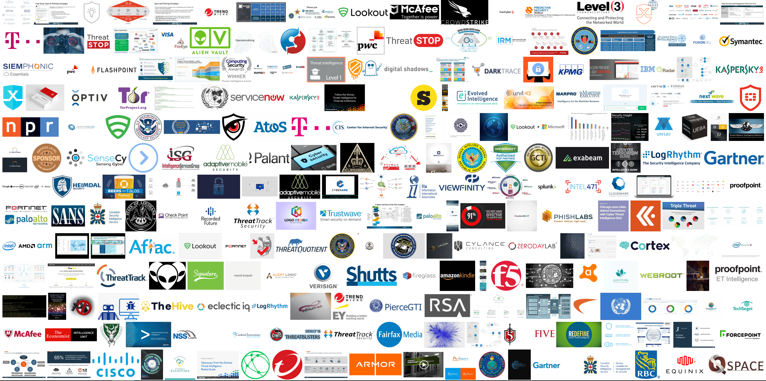
Notes:
Thee companies are the builders of this internet, and those who’ve chosen to help protect it. There are a LOT of companies… thousands in the security space alone.

Slide 3
Notes:
Good idea. Bad execution. Governments paint everything with wide brush strokes. Do we need privacy law? Absolutely. Does one size fit all? NO.

Slide 4
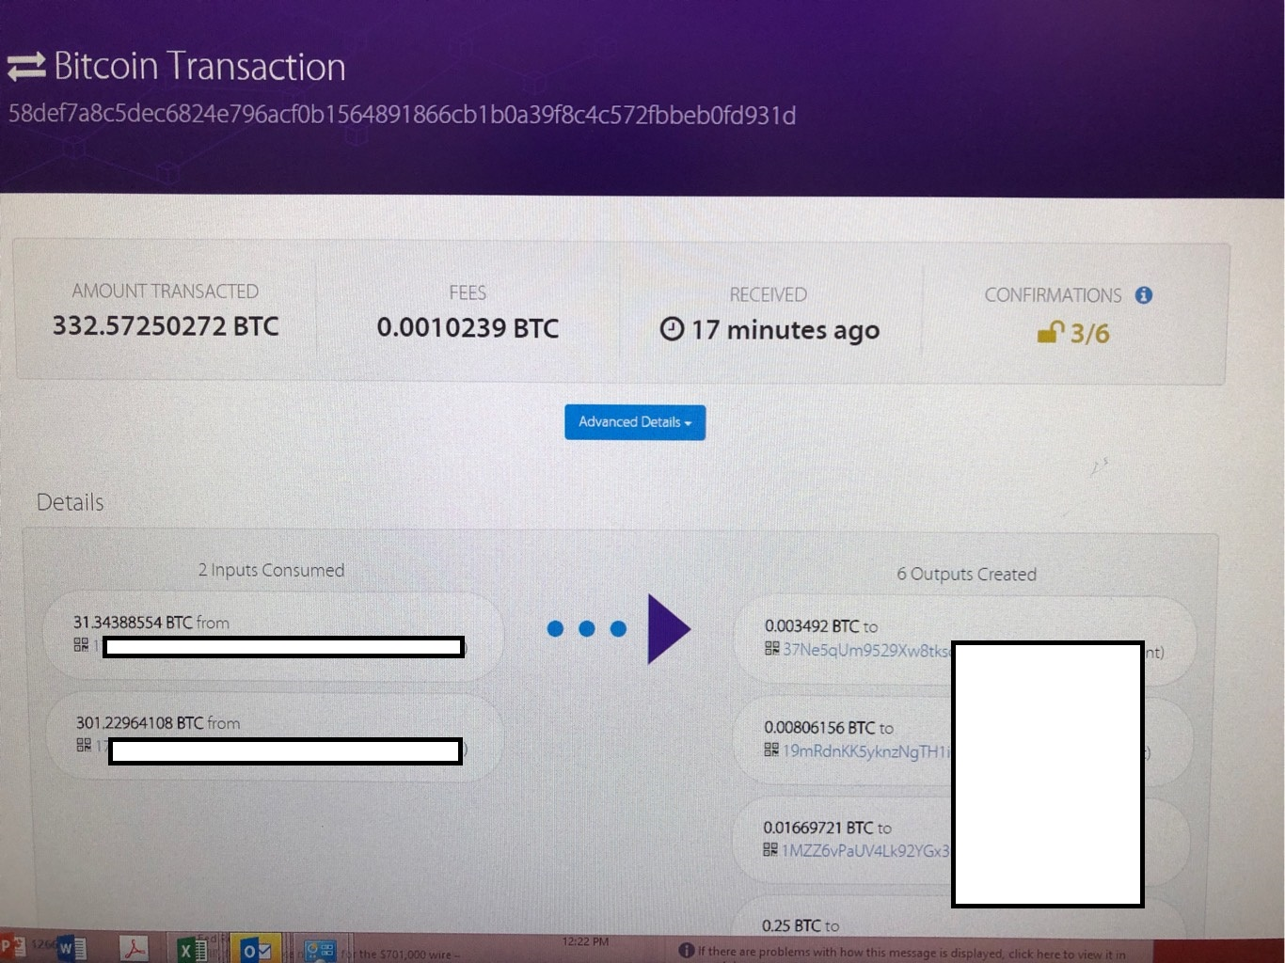
This sucks.
$100,000
Notes:
Have you ever had to do this? This is a ransomware payment and they’re demanding more and more every day.
There are options --reverse engineering code, rebuilding servers from backups, or ignoring the demand. Me I want to hunt.

Slide 5
GDPR isn’t good for Incident Response
Do you know what happens when you try and investigate that ransomware case? NOTHING. Domains are blocked out for privacy.
Notes:
Unfortunately for us, GDPR really takes away a major advantage in our ability to both protect our networks, and hunt down perpetrators. Domains are blacked out, and finding the real bad guy, as hard as it was before, has become even harder.

Slide 6
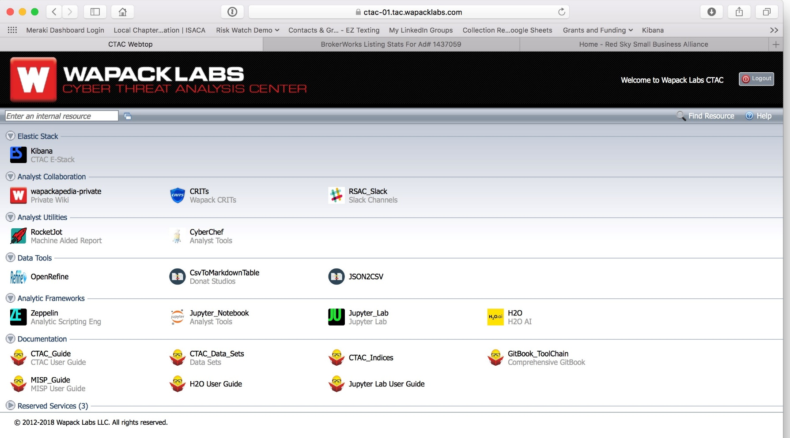
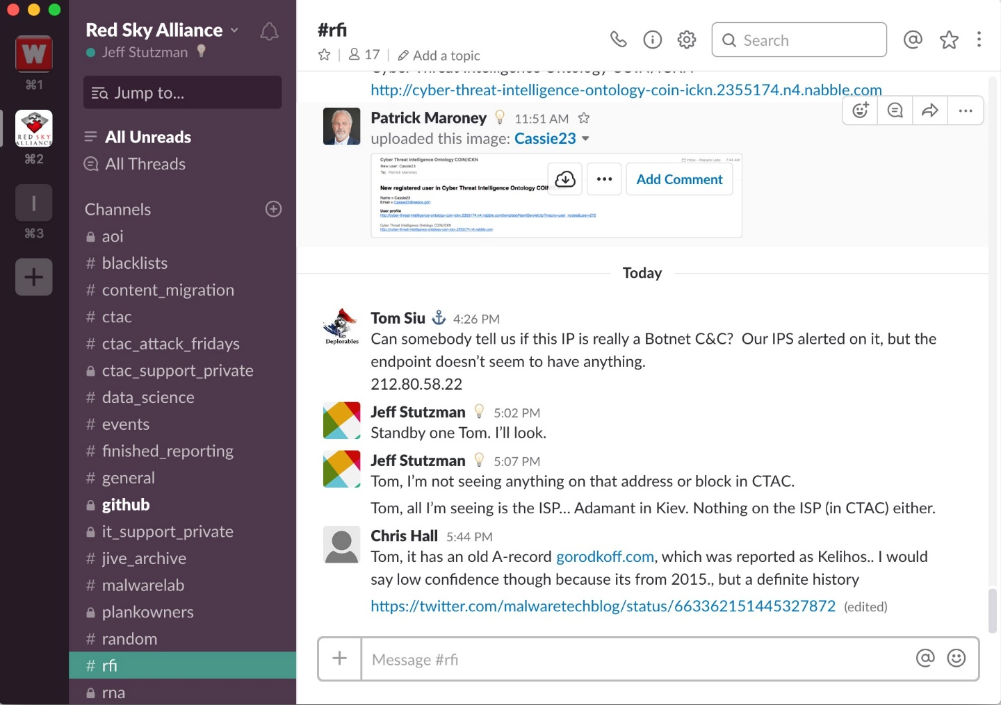
So what’s the answer? Information sharing.
Analysis tools, technical intelligence, real time information sharing over Slack
Notes:
So what are we supposed to do? We share information –at the human level and at the technical level. Red Sky Alliance was built for larger companies. We exchange data with people, but at the same time pull technical information from managed devices. Two days ago we loaded intelligence into a FortiSEIM in a company that’s loaded up with Cisco Firepowers, Meraki UTMs, and a suite of FortiNet devices. Within hours of loading our data, we began seeing new activity… over 30,000 connections made by four machines to a C2 that we knew about, but somehow neither Cisco nor FortiNet did. How does that happen? We hunt and we exchange information actively. What’s old is new again. See something, say something. Someone else might not have seen it yet.

Slide 7
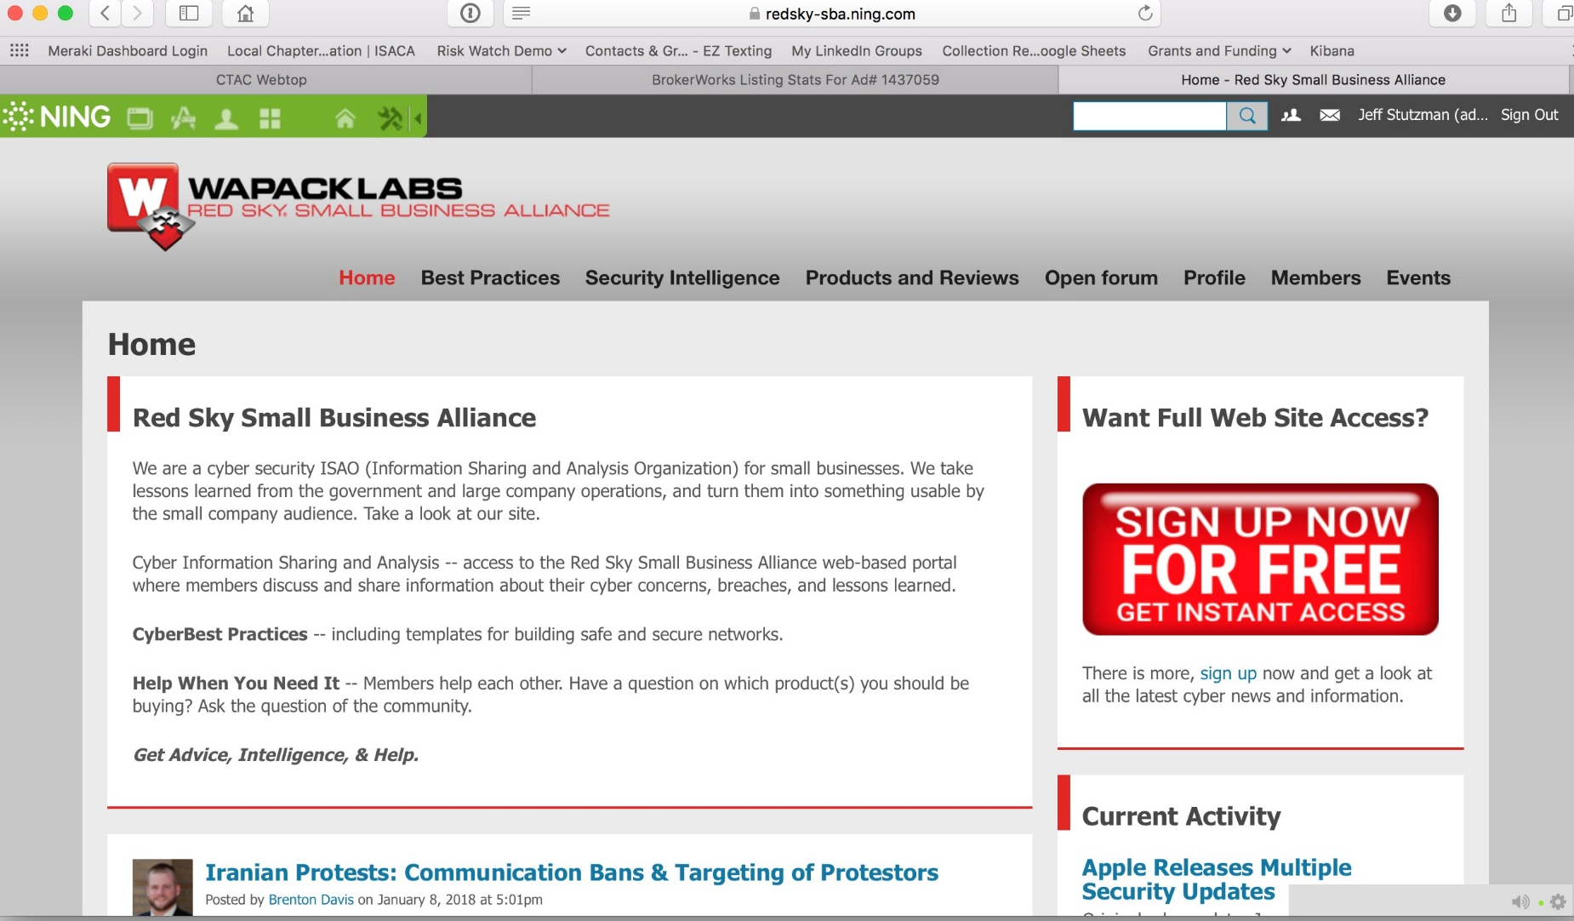
Information Sharing
No cost to participate
Includes human readable intelligence
US CERT Advisories
AIS
Wapack Labs
FREE for companies considered Small Business by the SBA.
< 500 employees
< 1500 for manufacturers
Notes:
For the small business, we make it even simpler Access to the portal is free, and we have a low cost MSSP offering that’s monitored by the analysts in Wapack Labs. We take lessons from larger companies and use them to help protect the small. Information sharing between companies with loads of data, shared with companies who don’t have that kind of access, instrumented and monitored by an expert analytic team. Sounds like a win-win right?

Slide 8
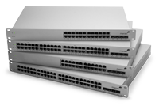
Low Cost Managed Security
Notes:
Managed security solutions start at $10 per month. VPN into our secure hub or deploy one of our boxes. You deploy it, we manage it. Intelligence is built in. Information Sharing comes in the idea that all of our customer benefit from the visibility of others

Slide 9
Intelligence
This is the most simple form of Intelligence.
Yet, most small businesses have no way of using it.
Notes:
Does this make you GDPR compliant? No, but it makes it easier to find information, exchange information, and instrument your networks with the lessons learned from others.

Slide 10
Where do you start? You start at Step 1.
Join Red Sky Alliance or the Small Business Alliance
Already have defenses? Point your logs at us.
We push/publish weekly blacklists.

