Slide 1


Information Sharing and Analysis Organization (ISAO)
Standards Organization
Online Public Meeting
20 OCTOBER 2016
A secure and resilient Nation – connected, informed and empowered.

Slide 2
Agenda
Why Are We Here?
Information Sharing with DHS
Initial Voluntary Guidelines
What’s Next?
Growing the Ecosystem
Resource Library
ISAO Registry
National Information Sharing Conference
Questions & Answers

Slide 3
Why Are We Here?
“The cyber threat is one of the most serious economic and national security challenges we face as a Nation.”
President Barack Obama, March 2010
Mission: Improve the Nation’s cybersecurity posture by identifying standards and guidelines for robust and effective information sharing and analysis related to cybersecurity risks, incidents and best practices.
Vision: A more secure and resilient Nation that is connected, informed and empowered.

Slide 4


Information Sharing with DHS
W. Preston Werntz
Chief of Technology Services
National Cybersecurity and Communications Integration Center (NCCIC)

Slide 5

Automated Indicator Sharing (AIS)
Notes:
Presentation is about 45 minutes with 15 Q&A

Slide 6
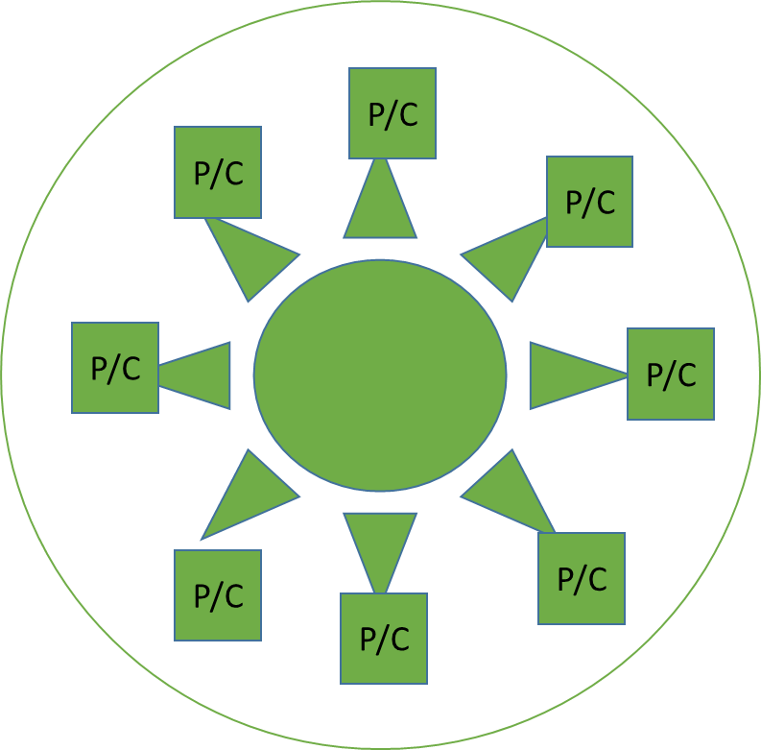
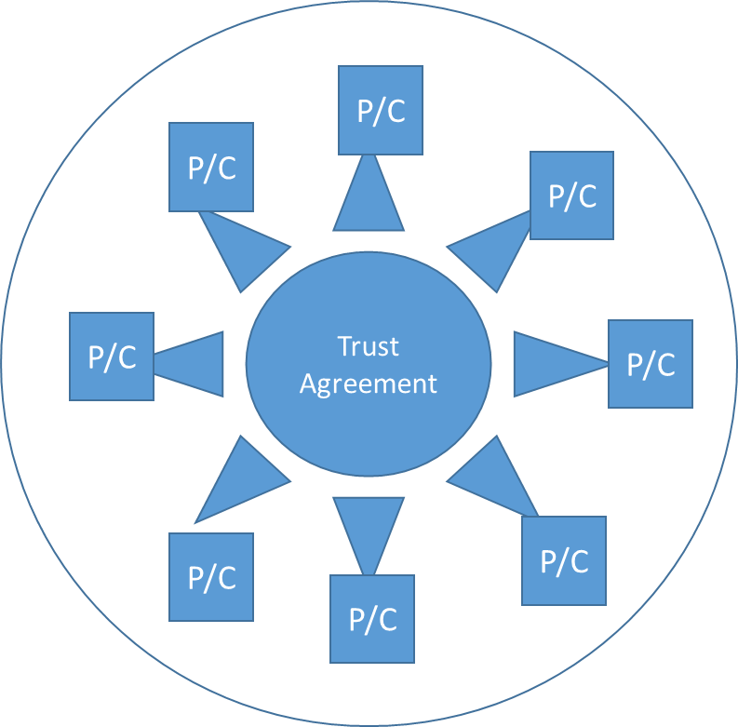
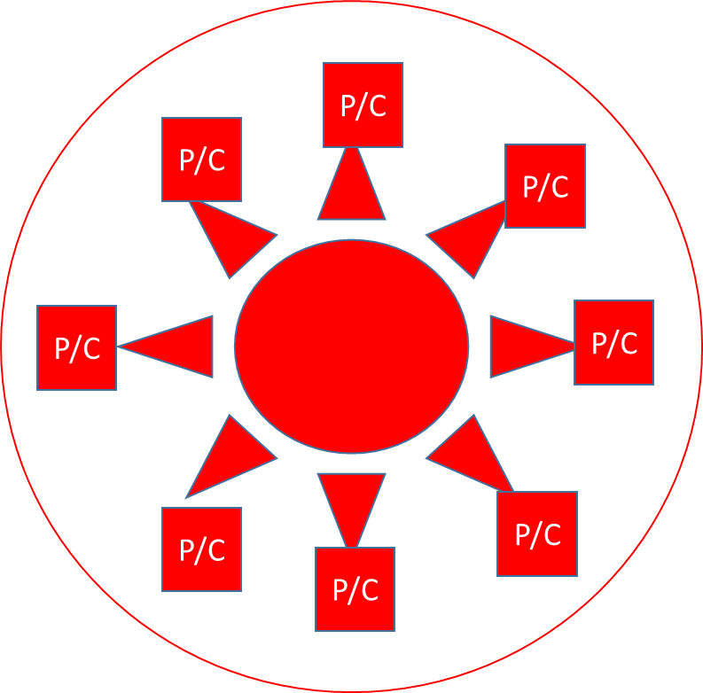
Trust Brokering Concept
  Brokers work between communities in accordance with the Trust Models of the two or more trust communities being brokered
  Brokers may also host automated, machine-speed brokering services allowing communities to work together by filtering, translating, transferring, controlling access, stewarding, consolidating and enriching – in accordance with each brokered community’s Trust Model
Broker
Broker

Slide 7
Programs for sharing with the NCCIC
Cyber Information Sharing and Collaboration Program (CISCP) supports broad sharing of cyber threat data (indicators, analytic content, etc.) in multiple formats with direct company analyst to DHS analyst collaboration and access to the NCCIC operations floor. Also includes ability for DHS to sponsor clearances (for classified threat briefs).
Automated Indicator Sharing (AIS) is about sharing machine readable cyber threat indicators near-real-time.

Slide 8
Cybersecurity Information Sharing Act (CISA) of 2015
The Cybersecurity Information Sharing Act (CISA) of 2015, which is designed to increase cybersecurity information sharing between the private sector and the Federal Government, required DHS to have an automated capability to receive and share cyber threat indicators and defensive measures.
Non-Federal entity sharing with DHS through AIS or other DHS mechanisms that is conducted in accordance with CISA’s requirements (e.g., privacy scrubs) receives liability protection.

Slide 9
Value Proposition
(“What’s in it for me?”)
Why do I want these indicators?
Receiving cyber threat indicators (and defensive measures) allows organizations to improve their network defense posture faster and forces adversaries to change their infrastructure, tactics, etc.
If your organization cannot make use of them directly (e.g., outsourced infrastructure), you should make sure your service provider is receiving and using.
Why do I want to share indicators back?
Your detection becomes someone else’s prevention and makes the entire community stronger (think of animals in a large herd).
Liability protection.

Slide 10
Plugging into AIS
Sign the AIS Terms of Use
Decide on how you’d like to connect
Ensure you have processes and policies in place for receiving and sharing indicators

Slide 11






You Host the Connection
Indicators are pulled from the DHS TAXII server via your own TAXII capability where they can be used in multiple ways.
Analysts
TAXII
client
AIS Indicators
Security
devices
Splunk, etc.
Soltra Edge,
etc.
DHS TAXII Server
Database

Slide 12
Someone Else Hosts the Connection
Indicators are pulled from the DHS TAXII server into a commercial threat intelligence provider or other hosted solution and accessed by security staff through a user interface.
Analysts and
security engineers
AIS Indicators
Anomali,
ThreatConnect,
IID,
Lookingglass,
GuidePoint,
etc.
DHS TAXII Server
Threat intelligence
Provider platform or
hosted solution

Slide 13
Receiving from AIS
Activities | Things to Think About
Decide how to use the incoming STIX information. | How will you determine which indicators or defensive measures apply to your organization? Will you take automated action with them, or send to analysts for review?
Getting the STIX information to your security end-points. | Do your security products speak STIX natively, or will you need to transform it before loading it up?
Sharing feedback to DHS. | Can you provide feedback to DHS on quality of indicators? Did you detect potential malicious activity previously unknown?
Further sharing the AIS indicators. | Is that allowable via the TLP marking? Do you have processes or technical controls in place to manage that sharing.

Slide 14
Sharing to AIS
Activities | Things to Think About
Decide what information you want to share. | Who owns the information? What restrictions are there on sharing it? Do you want to remain anonymous to the broader community when you share it? Do you have processes in place to perform a privacy review before sharing it?
Format the information into STIX. | If not already in STIX, do you need to manually transform it? Do you own any security products that speak STIX natively?
Getting the STIX content into your TAXII client. | Do you need to build or buy a TAXII client? Do one of your security products already speak TAXII natively?

Slide 15
Privacy Scrub
The Cybersecurity Information Sharing Act (CISA) of 2015 requires entities to conduct a privacy review before sharing to DHS in order to receive liability protection.
DHS always performs another privacy review upon receipt of indicators.
  All indicators go through an automated or manual privacy review.
  Any part of an indicator that fails an automated review goes to a DHS analyst for review.

Slide 16
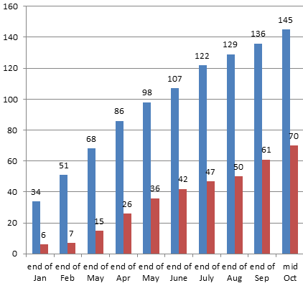
AIS Snapshot
145 Terms of Use signed, 56 non-Federal entities connected to server
12 Federal entities connected
  DOE, NCIJTF, TREAS, NTOC, DOC, HHS, DOI, GSA, EPA, DHS SOC, FBI SOC, USAID and EDU
~36,100 total unique indicators shared (since March)

Slide 17
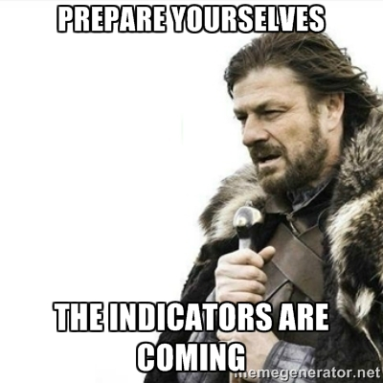
Questions?
https://www.us-cert.gov/ais
    https://www.oasis-open.org/committees/tc_home.php?wg_abbrev=cti
    http://www.us-cert.gov/tlp
preston.werntz@hq.dhs.gov
ncciccustomerservice@hq.dhs.gov
Please use the Question and Answers box in the GoToWebinar Control Panel to submit questions.

Slide 18
Meeting the Urgent Need
1st Public Comment Period Opens
1st Public Comment Period Ended
2nd Public Comment Period Opens
2nd Public Comment Period Closes
Public Meeting #4 – Tysons, VA
Online Public Meeting
ISAO Guidelines Published
Online Public Meeting
Online Public Meeting
Online Public Mtg
. . . .
May 5 2016
July 22 2016
June 17 2016
July 21 2016
June 23 2016
August 5 2016
October 20 2016
September 30 2016
September 22 2016
August 31 – September 1 2016

Slide 19
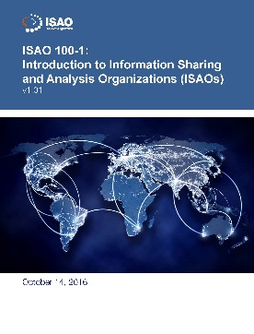
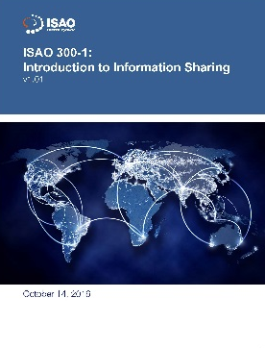
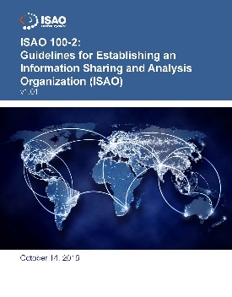
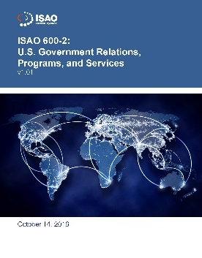
Hot off the Press
    Evolving Community Body of Knowledge
    Initial voluntary guidelines published 30 Sep 2016
      ISAO 100-1, Introduction to ISAOs
      ISAO 100-2, Guidelines for Establishing an ISAO
      ISAO 300-1, Introduction to Information Sharing
      ISAO 600-2, U.S. Government Relations, Programs, and Services
    Minor corrections addressed in v1.01
    Now, spread the word and implement!
Give us your feedback: Contact@isao.org

Slide 20
What’s Next? (1 of 3)
ISAO SO solicited inputs for follow-on docs beginning 1 Sep
Currently considering the following:
  ISAO 400-1: INTRODUCTION TO PRIVACY AND SECURITY
    An intro – midlevel discussion of privacy and security issues
    Incorporates WG4 Needs Assessment “Best Practices to Advance Privacy and Security in Private Sector Information Sharing”
  ISAO 500-1: INTRODUCTION TO ANALYSIS
    An intro – midlevel discussion of that other part of information sharing…the A in ISAO
  ISAO 800-1: INTRODUCTION TO LEGAL ISSUES FOR ISAOs
    An intro – midlevel discussion of the legal questions and considerations that arise in forming an ISAO
  ISAO 300-2: INFORMATION SHARING METHODS (ARCHITECTURE)
    A midlevel look at the subject of Information Sharing and the various methods that can be used – goes beyond the descriptions in ISAO 300-1 to provide “How To” info for new ISAOs

Slide 21
What’s Next? (2 of 3)
Also currently considering the following:
  ISAO 300-3: AUTOMATED INFORMATION SHARING
    A midlevel technical discussion of automated information sharing and its impact on the ecosystem
  ISAO 600-1: INTRODUCTION TO THE ROLE OF GOVERNMENT
    Introduces the 600 series on the relationship between the private industry and government
  ISAO 600-3: STATES, LOCAL, TRIBAL & TERRITORIAL ISSUES
    An intro – midlevel discussion of issues impacting information sharing at subnational levels
  ISAO 700-1: INTRODUCTION TO GLOBAL SHARING
    Introduces the 700 series on information sharing on a global scale
  ISAO 200-1: INTRODUCTION TO ISAO CAPABILITIES AND SERVICES
    Introduces the 200 series on Capabilities and Services of an ISAO and provides an intro – midlevel discussion of the various capabilities and services an ISAO may consider adopting

Slide 22
What’s Next? (3 of 3)
The ISAO SO is engaged with working group leaders to discuss priorities and assignments
Submit suggestions for new documents to Contact@isao.org

Slide 23



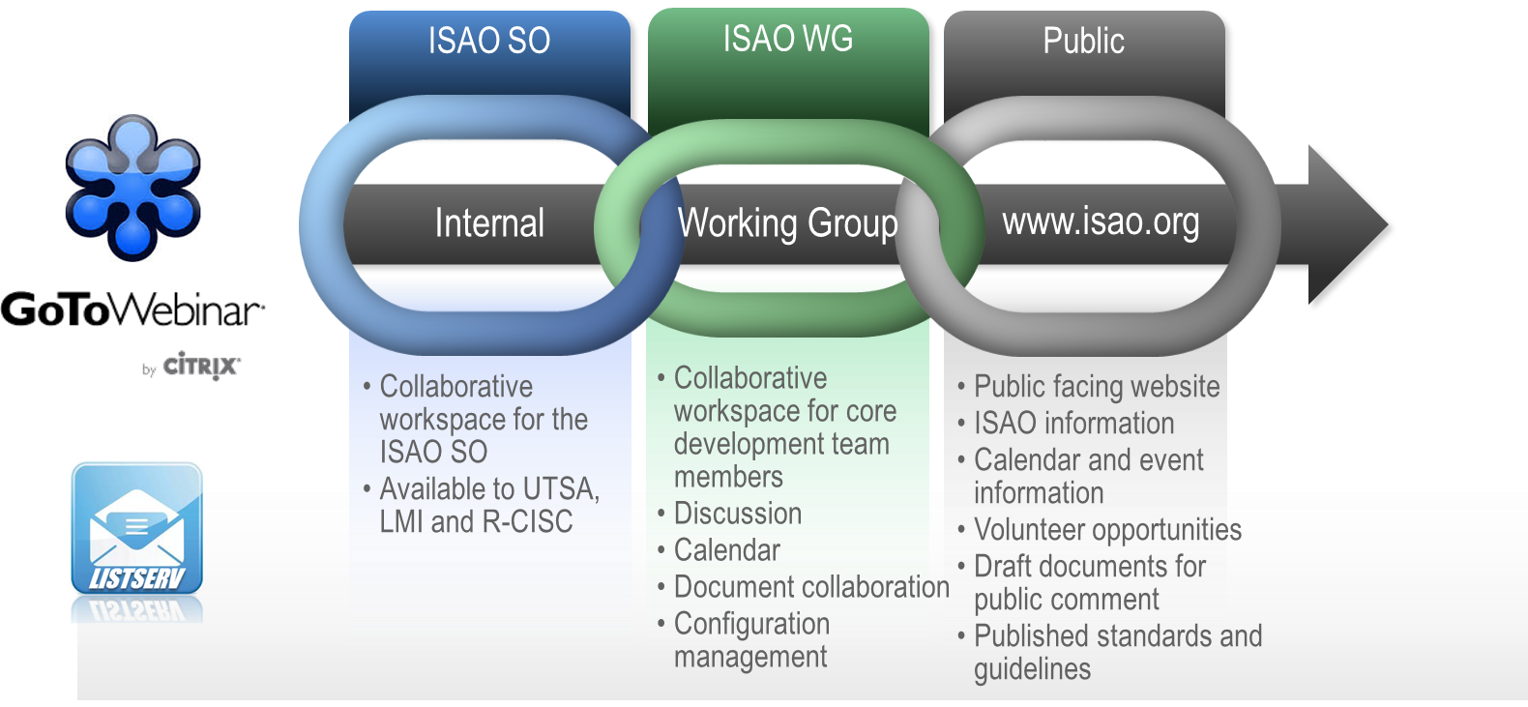

Building the Community
Working Group Evolution
Refining Collaboration Infrastructure
Broadening Outreach by Leveraging Networks
Creating Venues for Online and Face-to-Face Interaction

Slide 24
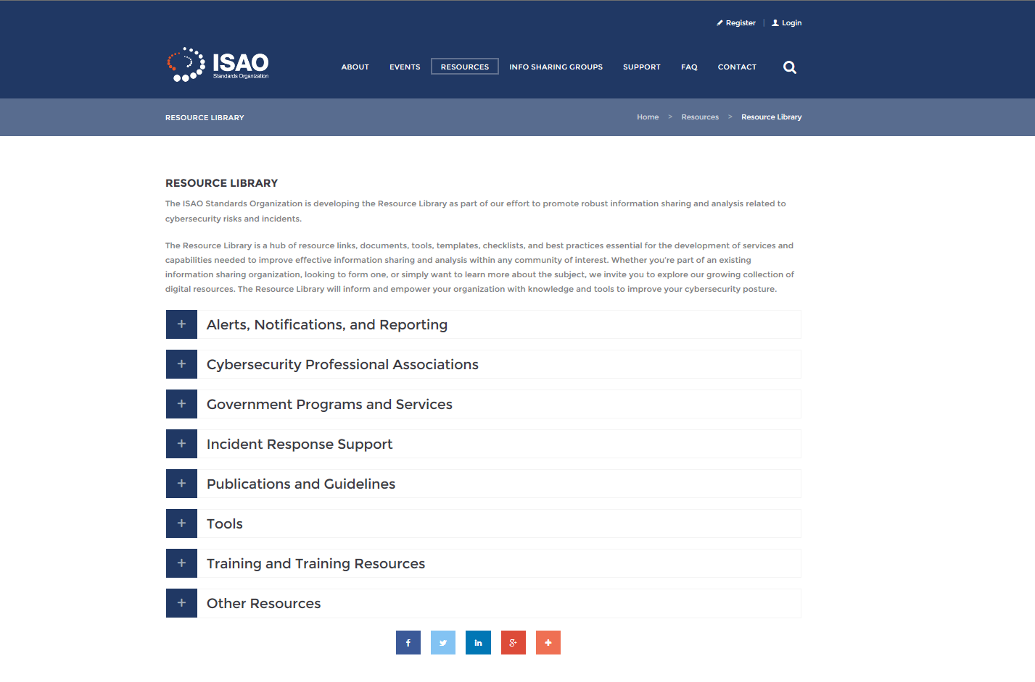
Information Sharing Resource Library

Slide 25
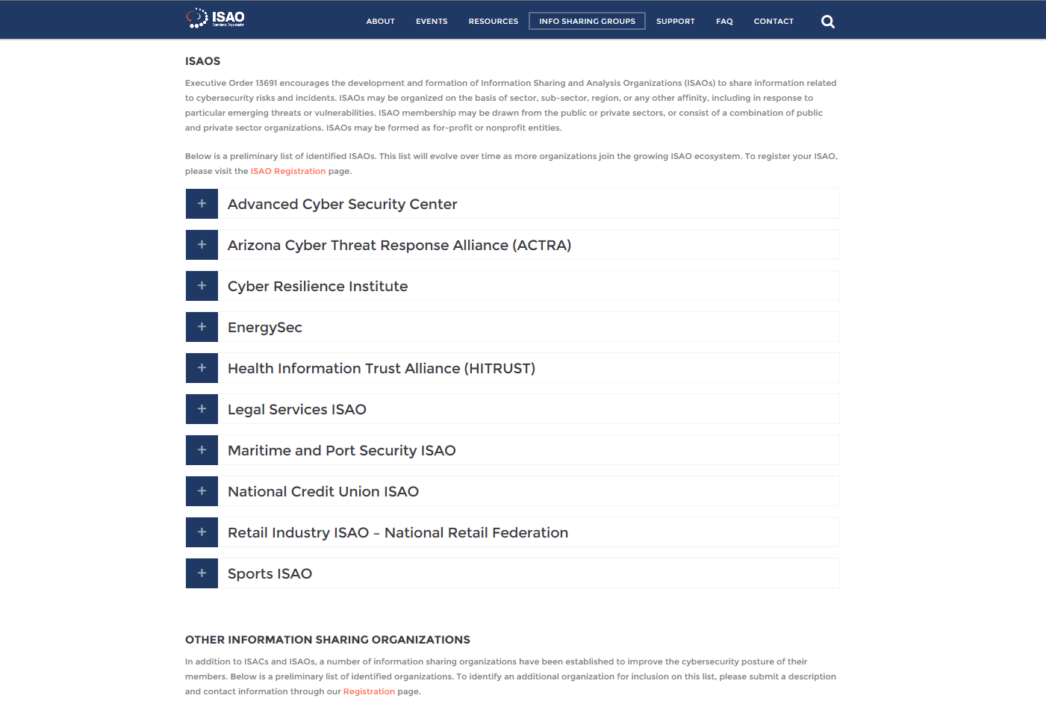
Information Sharing Groups

Slide 26
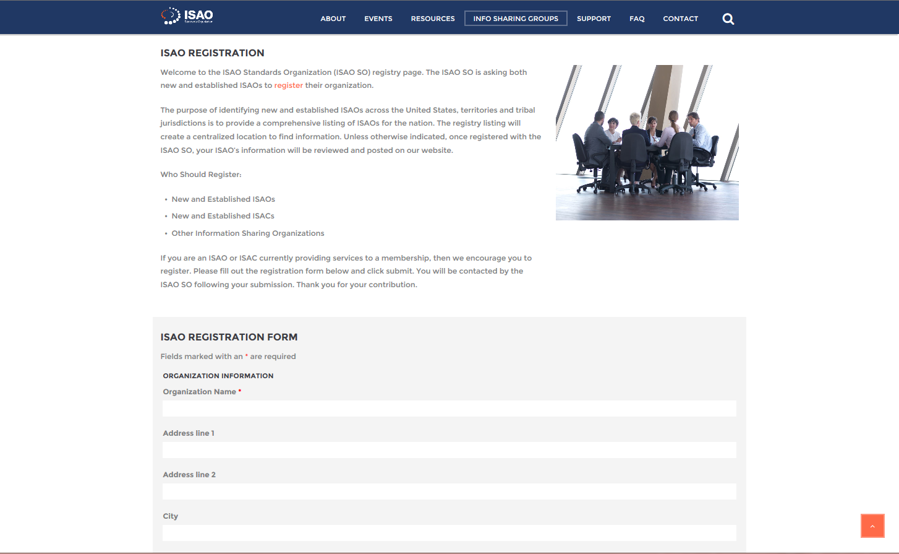
ISAO Registry

Slide 27
ISAO Roundtable Discussions
ISAO Monthly Online Round Table Discussion
A Platform for new and emerging ISAOS
  Peer-discussions and sharing of ideas
  Present challenges or obstacles and discuss solutions
  Highlight resources, tools and training opportunities
  Guest Speakers

Slide 28

National Information Sharing Conference
ISAOs
Service Providers
Training Sessions
Call for Papers
2017 Date and Location TBD
  Considering spring and fall options
Bringing the Community Together

Slide 29
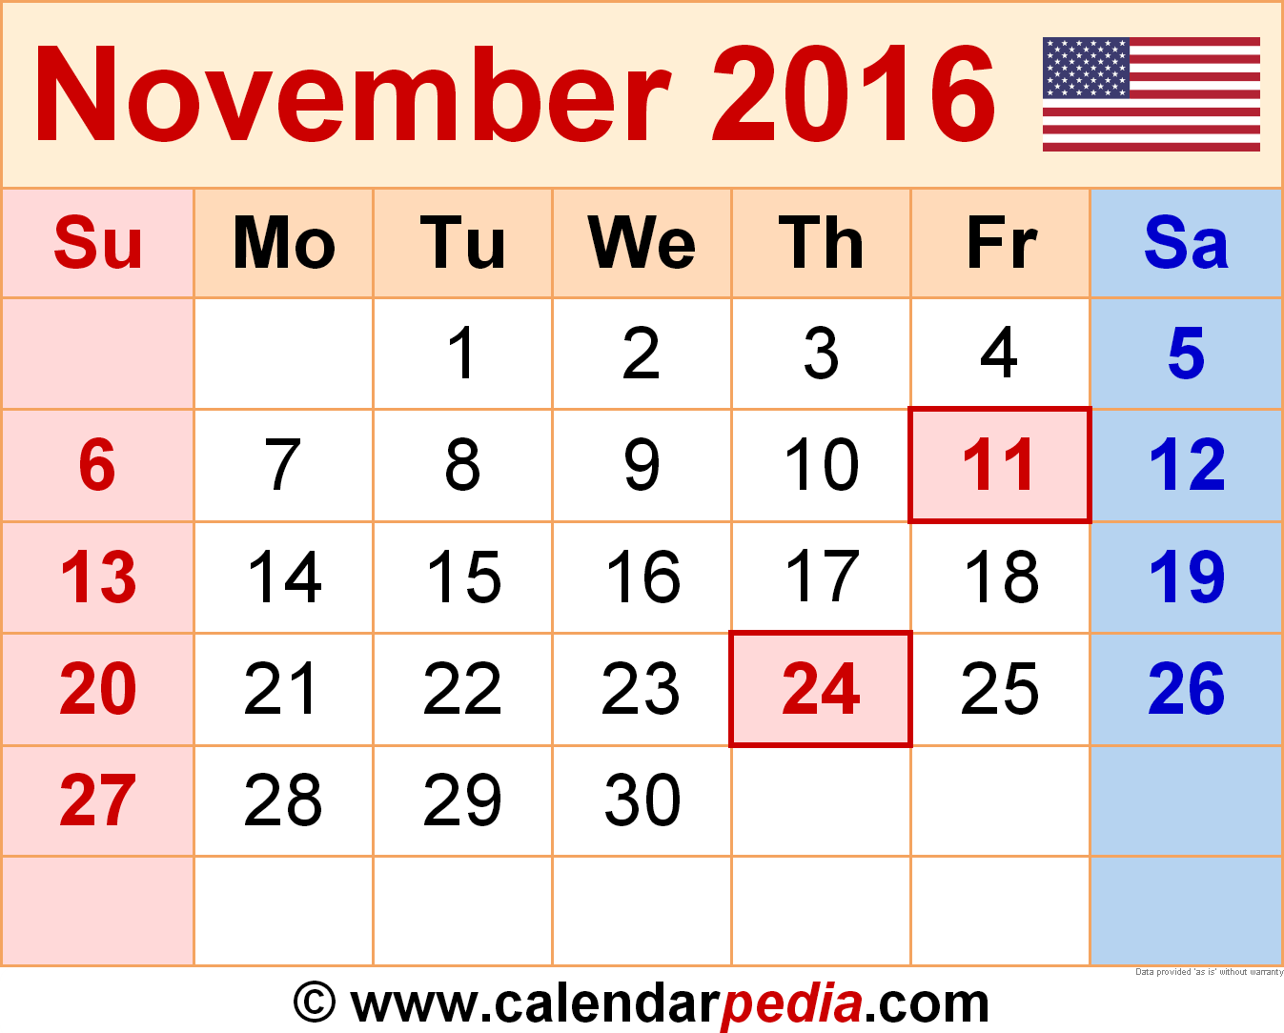
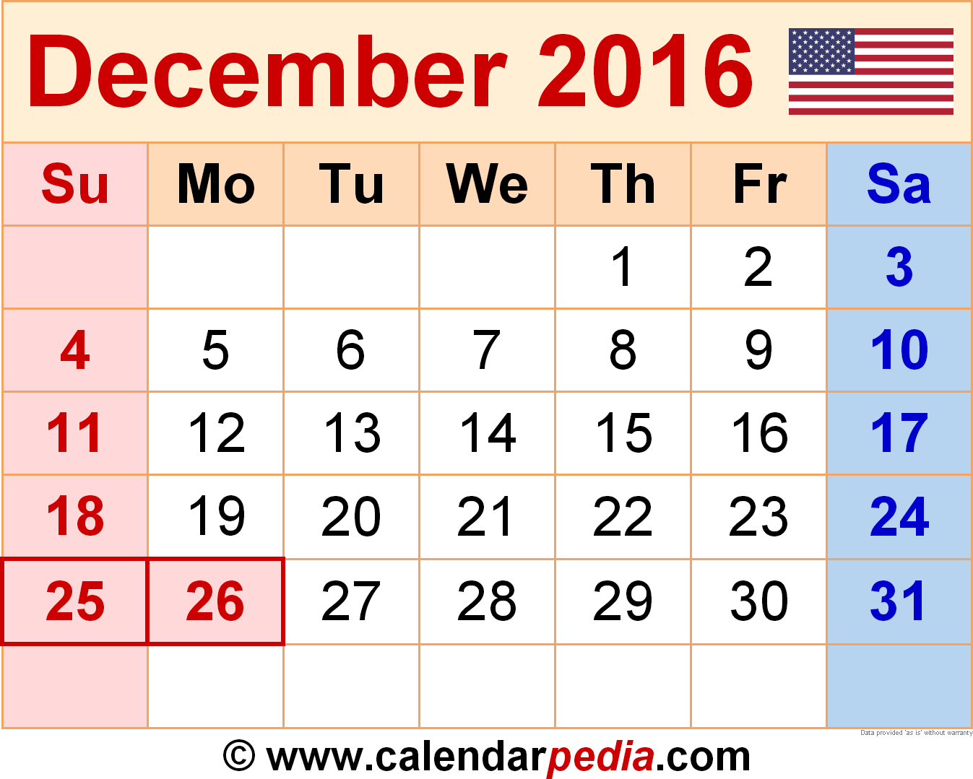
Mark Your Calendars
Online public meetings at 1pm Central time
Information sharing insights, updates from the ISAO SO, and your chance to engage

Slide 30
Questions and Answers
Please use the Question and Answers box in your GoToWebinar Control Panel to submit questions to the ISAO SO.
Thanks for joining our online meeting today!

