Slide 1
Welcome to the Fourth Public Meeting of the Information Sharing and Analysis Organization (ISAO) Standards Organization
A secure and resilient Nation: connected, informed and empowered.
September 1, 2016

Slide 2
Information Sharing and Analysis Organization (ISAO) Standards Organization
Administrative Remarks
Dr. Heidi Graham
Senior Fellow, LMI

Slide 3
Administrative Information
Badges and building access
Please wear your badge at all times
Unregistered attendees go to the Information Desk
Restrooms located in the internal corridor of Northwest quadrant of the building
LMI is a smoke free environment
Walking path is not LMI property
Food
Continental breakfast available now
Coffee available all day
Lunch scheduled for 12:00
Emergency Procedures
Exit the building through the main entrance
Proceed to the open area across the driveway

Slide 4
Public Forum Rules
Your input is important!
Constructive ideas are essential to this national dialogue
Respect your colleagues’ opinions
The forum will be recorded and posted on www.ISAO.org
Debate and Discussion Time
We will start promptly at the end of each break and lunch
Please give your name and organization before asking a question
Please limit comments / questions to 1 minute
Electronic Devices
Please mute cell phones and take calls outside
Access WiFi using GuestNet and credentials on your badge
Charging stations are located throughout the conference center
Thank you for contributing to this important work!

Slide 5
Thank You to our Food and Beverage Sponsors

Slide 6
Information Sharing and Analysis Organization (ISAO) Standards Organization
Welcome
Nelson Ford
President and CEO, LMI

Slide 7
Strengthening the Nation’s Cybersecurity Posture
Michael Daniel
Special Assistant to the President and Cybersecurity Coordinator
Notes:
Brad Howard

Slide 8
State of the Ecosystem: Where We Are and Where We’re Going
Gregory B. White, Ph.D.
Director, ISAO Standards Organization
Notes:
Brad Howard

Slide 9
Why is Cybersecurity Information Sharing Important?
“In our industry, we are constantly one or two steps behind the hackers. Over the past several years, the prevailing sentiment is that coming together as a security community to better combat these attacks would make our jobs easier and allow our clients, and us, to sleep better at night. At the same time, this practice would provide security teams the breathing room to focus on higher-value activities, like detecting and researching anomalous behavior.”
https://www.rsaconference.com/blogs/why-cybersecurity-information-sharing-is-important#sthash.jjGbbNbW.dpuf

Slide 10
Mission and Vision of the ISAO Standards Organization
“The cyber threat is one of the most serious economic and national security challenges we face as a Nation.”
President Barack Obama, March 2010
Mission: Improve the Nation’s cybersecurity posture by identifying standards and guidelines for robust and effective information sharing related to cybersecurity risks/incidents and cybersecurity best practices.
Vision: A more secure and resilient Nation that is connected, informed and empowered.
(This means we need more than just the critical infrastructures to be part of the information sharing program, we need every sector/industry/agency/individual.)

Slide 11
Creation of an Information Sharing Ecosystem
Information Sharing and Analysis Centers (ISACs) were created over a decade ago to address the needs of the nation’s critical infrastructures.
The majority of organizations/businesses are not part of one of the critical infrastructures, but they need to be engaged in information sharing as are entities that are related to a critical infrastructures.
We need to build an “ecosystem” that will include all individuals and organizations that want to participate in information sharing.

Slide 12
(From a DHS briefing): Empowering Communities
Aviation
ISAC
Orthopedic Doctors
School Systems
Alabama Baptists Ministers
ISAO Program
ISAO
Standard Organization
ISAO Service Providers
National
Bar Association
SW U.S. Mariachi Bands ISAO
Association of Online Auction Professionals
Health
ISAC
State of Texas ISAO
Mariachi Bands of Texas ISAO
Financial Services ISAC
Automotive Manufacturers
Law Enforcement
From ~ 20 Sector -based entities with varying ideas of ISAC member qualification and requirements…… to
Game Changer
1000s of potential sharing entities (with unlimited numbers of members) built on baseline requirements for trusted sharing.
Incoming information
Outgoing information

Slide 13
Examples of members of the ecosystem
Commercial or Sector ISAO
Shoe Retailers ISAO
Alabama Baptist Ministers ISAO
“Tiered” ISAOs for a given industry
National Association of Mariachi Bands ISAO
SW U.S. Mariachi Bands ISAO
Mariachi Bands of South Texas ISAO
Geographically based ISAOs
State of Texas ISAO
City of San Antonio ISAO
ISAO Service Providers
Providers of services to ISAOs
Providers of services to individual organizations not part of an ISAO – a commercial ISAO
Special Event ISAOs
Super Bowl ISAO
Groups of Security-minded Individuals
San Antonio Security Leaders Forum
Government (and industry) Information Sharing organizations
Not all ISOAs may want to participate in sharing with government agencies or other specific info sharing entities
Each of these has a place in the ecosystem. We need to ensure we have provided a way for them to fit in.

Slide 14
So what information can an ISAO share?
Security relevant indicators
Security relevant incident data (in real-time is the ultimate goal)
Analysis that leads to actionable activities
Best practices
Security training / awareness
Tools or an analysis/evaluation of tools
Trends that might impact the members of the ISAO
Recommendations on countermeasures
Analysis of Sector and Common Applications

Slide 15
So what services/capabilities can an ISAO Provide?
Sharing of information with members
Based on needs and charter of the ISAO
Interface and communication with other ISAOs and government agencies
Again, depends on needs of the members of the ISAO
Represent the members in information sharing and security forums
Analysis of sector-relevant security information
24/7 security operations alert center
Assistance with incident response
… many others
Ultimately, the ISAO is the link into the national information sharing ecosystem for its members!

Slide 16
So, who should form an ISAO?
LOTS of people!
The State of Texas (others have already started)
Communities within the state
Industry sectors or portions of sectors with common interests
You may elect to be part of multiple ISAOs
Geographic and functional
Tiered ISAOs (national, regional, local)
The services offered by an ISAO will vary and will depend on the goal of the ISAO and what its members want.
Share with other ISAOs? Share with the government? Assist in incident response? 24/7 SOC?
You may want to contract with a service provider versus developing your own services

Slide 17
Questions?
Dr. Gregory White, Executive Director, ISAO SO
Greg.White@utsa.edu, (210) 458-2166
Mr. Rick Lipsey, Deputy Director, ISAO SO and Director, Stakeholder Engagement
RLipsey@lmi.org, (210) 526-8186
Mr. Brian Engle, Executive Director, R-CISC
Brian.Engle@R-CISC.org, (202) 679-5670
Mr. Larry Sjelin, Director, Standards Lifecycle Management
Larry.Sjelin@utsa.edu, (210) 458-2159
Ms. Natalie Sjelin, Director, ISAO Support
Natalie.Sjelin@utsa.edu, (210) 458-2174
ISAO SO Organizational E-mail: contact@isao.org
Notes:
Greg White

Slide 18
Information Sharing and Analysis Organization (ISAO) Standards Organization (SO)
BREAK
9:00 am – 9:20 am

Slide 19
State of the Ecosystem: What’s Next?
Rick Lipsey
Deputy Director, ISAO Standards Organization
Notes:
Brad Howard

Slide 20
Transitions
Where we’ve been
Turning the corner
Evolving a shared body of knowledge
Building the community
Supporting implementation
Are we growing the ecosystem and making it more capable?
Notes:
Rick Lipsey

Slide 21
Publishing Initial Guidelines
Sept 02 – 11: ISAO 100-1 Editorial Review Board
Sept 02 – 11: ISAO 600-1 SO Review Group
Sept 12 – 14: SWG Review of Documents
Sept 14 – 16: SO Reconciliation of SWG Comments
Sept 17 – 23: SO Final Review / Edits
Sept 24 – 29: SO Editors
Sept 30: ISAO 100-1 & 600-1 Published

Slide 22
SO Editorial Review Board for ISAO 100-1
Brian Engle - Chair
Larry Sjelin
Frank Grimmelmann
Fred Hintermister
Kent Landfield
Bobbi Stempfley
Jon Baker
Board’s object is to ensure that ISAO 100-1 gives clear guidance to the establishment of a new ISAO, speaks to a specific target audience, contains the right level of detail, and speaks as one voice regarding the various topics addressed.

Slide 23
Organizing the Evolving Body of Knowledge
ISAO 100 Series: ISAO Creation & Operation
ISAO 100-1: Guidelines for Establishing an ISAO
ISAO 100-2: Guidelines for Operating an ISAO (?) *
ISAO 200 Series: ISAO Capabilities & Services
ISAO 200-1: ISAO Capabilities (?)
ISAO 200-2: ISAO Services (?)*
ISAO 300 Series: Information Sharing
ISAO 300-1: Information Sharing Methods (?)
ISAO 300-2: Automated Info Sharing (?)
ISAO 300-3: Analytical Methods (?)
ISAO 400 Series: Privacy and Security
ISAO 400-1: Privacy Guidelines (?)
ISAO 400-2: Security Guidelines (?)
ISAO 500 Series: ISAO Analysis
ISAO 500-1: Analytical Methods (?)
ISAO 600 Series: Government Relations
ISAO 600-1: US Government Relations, Programs & Services
ISAO 600-2: State, Local & Tribal Issues (?)*
ISAO 700 Series: International Issues
ISAO 700-1: International Issues (?)
Checklists
DRAFT
Templates
White Papers
Buyer’s Guide
Automated Tools

Slide 24
Document Development Guide
A checklist designed to balance creativity and consistency in future documents
Helpful when working group leadership / members are added or changed for continuity of effort
Help to minimize roadblocks
Establish transparency for document production
Development forms to be posted on ISAO.org

Slide 25
Needs Assessment Form

Slide 26
SO Document Planning / Analysis
Planning Phase:
Define scope of the document (how deep will it go)
Identify the SMEs needed in the CDTs
Create the milestones and schedule for the document creation
Analysis Phase:
Determine target audience (Management / Technical / other)
Determine outcomes of the document
Organize document content into a logical hierarchy
Identify supplemental templates, checklists, training to be developed to support the document
Submit Planning/Analysis Form to SO for approval

Slide 27
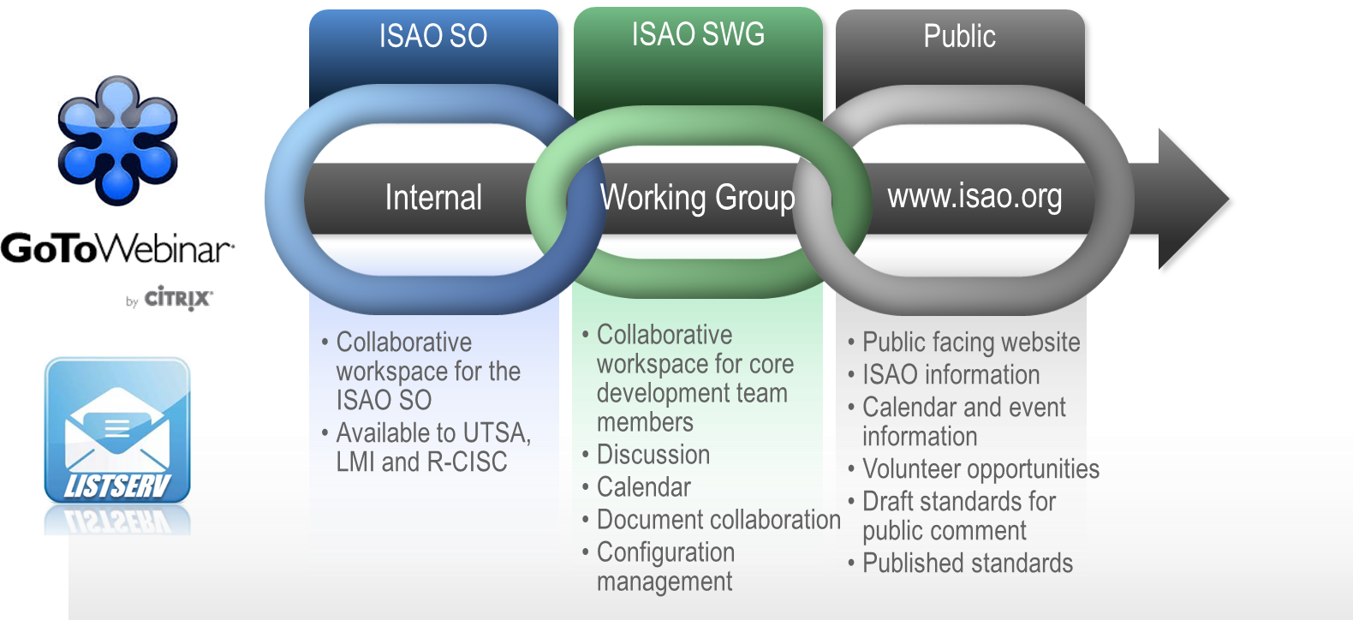
Building the Community
Working Group Evolution
Refining Collaboration Infrastructure
Broadening Outreach by Leveraging Networks
Creating Venues for the Right Face-to-Face Interaction

Slide 28
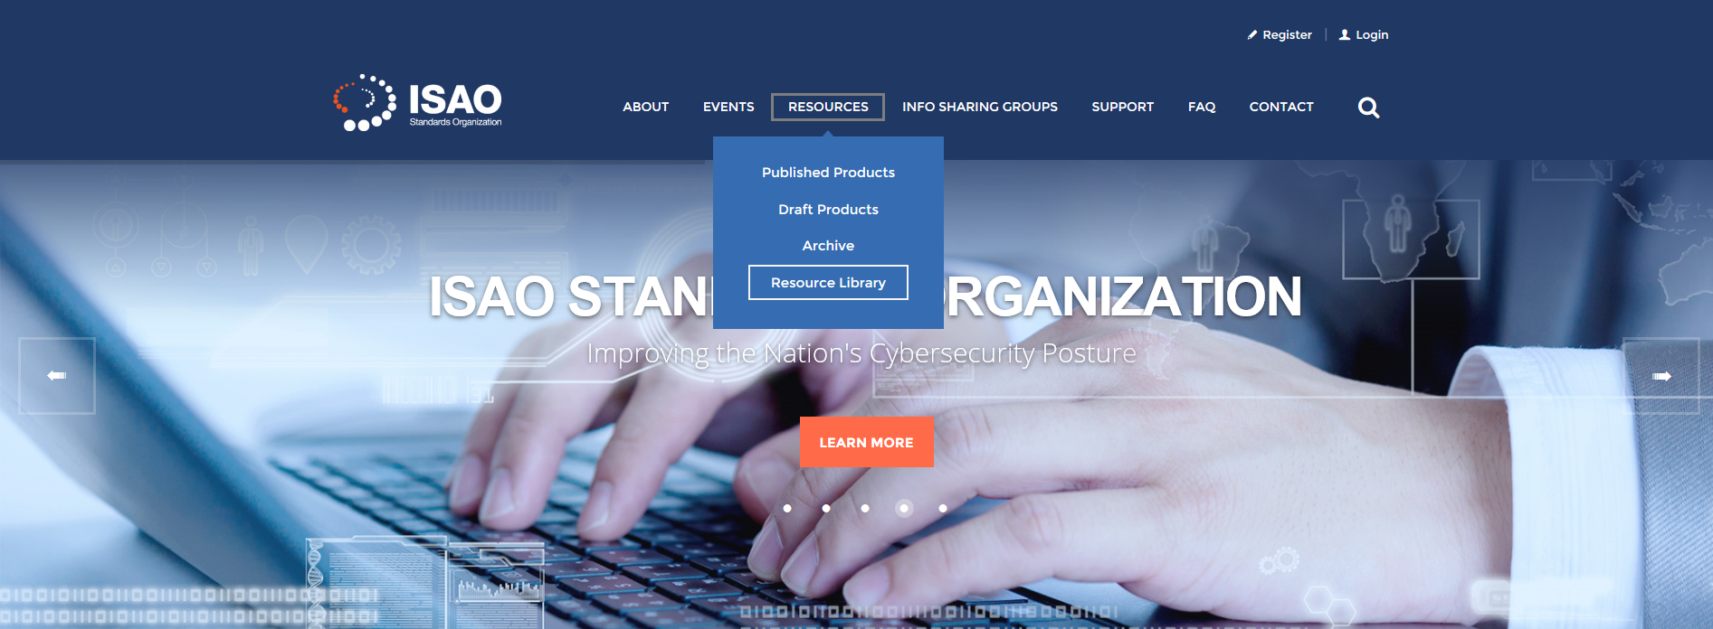
Supporting Implementation

Slide 29
Shaping the Way Ahead
?
Public Meeting #2 - San Antonio
ISAO 100-1 & 600-1 Published
Public Meeting #5 (?)
1st Annual National ISAO
Convention (?)
Public Meeting #3 – Anaheim
Next Documents Published (?)
Public Meeting #1 - Tysons
Initial Draft Documents Shared
Working Groups Created
Public Meeting #4 - Tysons
Kickoff
Sep 2016
Oct 2015
Jan 2016
Sep 2016
2Q 2017
Nov 2015
Feb 2016
May 2016
Fall 2017
May 2016
Spring 2017
Are we growing the ecosystem and making it more capable?

Slide 30
Supporting New and Emerging ISAOs
Natalie Sjelin
Director of Support, ISAO Standards Organization
Notes:
Brad Howard

Slide 31
Executive Order 13691
Promoting Private Sector Cybersecurity Information Sharing
The Purpose of the Executive Order (EO):
To encourage the voluntary formation of Information Sharing and Analysis Organizations (ISAOs)
To establish mechanisms to continually improve the capabilities and functions of these organizations
To better allow these organizations to partner with the Federal Government on a voluntary basis
Notes:
In supporting the Executive Order – ISAO SO Support will assist with the formation by providing resources and services

Slide 32
Introduction to the Standards Organization
Greg White, PhD
Executive Director
Rick Lipsey
Deputy Director
Brian Engle
Executive Director, R-CISC
Rick Lipsey, Director
Stakeholder Engagement
Larry Sjelin, Director
Lifecycle Management
Natalie Sjelin, Director
Support Services
Notes:
Each area of the Standards Organization works together.

Slide 33
Introduction to the Standards Organization
Engagement
Building the community
- Constituent Strategies
- Public Messaging
- Event Management
Lifecycle
Creating the guidelines
- Standards Process
- Standards Framework
- Work Group Oversight
Support
Implementing/Feedback
- Resource Mgmt.
- Support Services
- Feedback
Notes:
They are interconnected. Engagement works to promote awareness of the SO efforts; Lifecycle works with the working groups to establish guidelines; Support assists with the Implementation of the guidelines.

Slide 34
ISAO SO Support
Products
Standards & Guidelines
ISAO SO Products
Resource Library
Services
Product Identification & Location
Mentor Program
Training and Exercises
Customized Support
Info Sharing Registry
ISAC Listing
ISAO Listing
Other Sharing Org Listing
ISAO Listing
ISAC Listing
Engagement
Lifecycle
Support
Feedback

Slide 35
ISAO SO Support Products
Products
Standards & Guidelines
ISAO SO Products
Resource Library
(Industry Created)
Published Guidelines 100 – 600 Series (Topic focused) |  | FAQs Establishing an ISAO Operating an ISAO |  | Alerts, Notifications, Reporting Publications, Guidelines, Templates Training and Training Resources Cybersecurity Professional Organizations Incident Response Support Tools Other Resources
New Series (topic focused) identified not yet created |  | Implementation Templates Checklists Best Practices Whitepapers Publications
New Series (topic focused) not yet identified
 |  | Reports & Publications

Slide 36
ISAO SO Support Services
Services
Product Identification & Location
Mentor Program
Training and Exercises
Customized Support
Product Search Assistance of ISAO SO Products |  | Website listing of participating organizations |  | Webinars Tutorials Topic driven |  | Determine ISAO current need / assist with plan development
Product Search Assistance of Resource Library Products |  | Match Mentors with ISAOs |  | Workshops Exercises identifying gaps |  | Engagements with ISACS & ISAOs
Guidance on upcoming products |  |  |  | Online training |  | ISAO Round Table Online Mtgs

Slide 37
ISAO SO Information Sharing Group Registry
Info Sharing Registry
ISAC Listing
ISAO Listing
Other Sharing Org Listing
Who should register
New and Established ISAOs New and Established ISACs Other Information Sharing Organizations
Purpose of the registry
Feature ISACS and ISAOs Attract new members Display the ecosystem of information sharing organizations

Slide 38
ISAO SO Feedback
Engagement
Lifecycle
Support
Feedback
Marketing efforts |  | Standards Implementation |  | Products - ISAO SO Products - Resource Library
Public engagement |  | Identify new standards needed |  | Services - Mentor Program - Training & Exercises - Customized Support
Community building events |  |  |  | Info Sharing Registry

Slide 39
ISAO SO Support Products and Services
AVAILABLE NOW
Resource Library
Information Sharing Organization Registry
ISAO Round Table Discussions
Next Round Table Online Meeting, September 29, 2016
If you know of ISAOs who would benefit or would want to join these meetings, let us know and we will add them to our ISAO Round Table Discussion Group
COMING SOON
Mentor Program

Slide 40
ISAO SO Key Points of Contact
Dr. Gregory White, Executive Director, ISAO SO
Greg.White@utsa.edu, (210) 458-2166
Mr. Rick Lipsey, Deputy Director, ISAO SO and Director, Stakeholder Engagement
RLipsey@lmi.org, (210) 526-8186
Mr. Brian Engle, Executive Director, R-CISC
Brian.Engle@R-CISC.org, (202) 679-5670
Mr. Larry Sjelin, Director, Standards Lifecycle Management
Larry.Sjelin@utsa.edu, (210) 458-2159
Ms. Natalie Sjelin, Director, ISAO Support
Natalie.Sjelin@utsa.edu, (210) 458-2168
ISAO SO Organizational E-mail: contact@isao.org
Notes:
Greg White

Slide 41
Information Sharing and Analysis Organization (ISAO) Standards Organization (SO)
BREAK
10:40 am – 11:00 am

Slide 42
Panel Discussion: ISAO Services and Capabilities
Moderator: Brian Engle
Executive Director, Retail Cyber Intelligence Sharing Center
Notes:
Brad Howard

Slide 43
Information Sharing and Analysis Organization (ISAO) Standards Organization (SO)
LUNCH
12:00 pm – 1:00 pm

Slide 44
Panel Discussion: Building an ISAO
Moderator: Rick Lipsey
Deputy Director, ISAO Standards Organization
Notes:
Brad Howard

Slide 45
Information Sharing and Analysis Organization (ISAO) Standards Organization (SO)
BREAK
2:00 pm – 2:10 pm

Slide 46
Public Discussion
Moderator: Dr. Heidi Graham
Senior Fellow, LMI
Notes:
Brad Howard

Slide 47
Information Sharing and Analysis Organization (ISAO) Standards Organization (SO)
BREAK
3:25 pm – 3:35 pm

Slide 48
Public Discussion
Moderator: Dr. Heidi Graham
Senior Fellow, LMI
Notes:
Brad Howard

Slide 49
Closing Remarks
Rick Lipsey
Deputy Director, ISAO Standards Organization
Notes:
Brad Howard

